Slide 1

ParDiff:
Practical Static Differential Analysis of Network Protocol Parsers
V-SPELLS
Xiangyu Zhang
Samuel Conte Professor
Purdue University

Slide 2

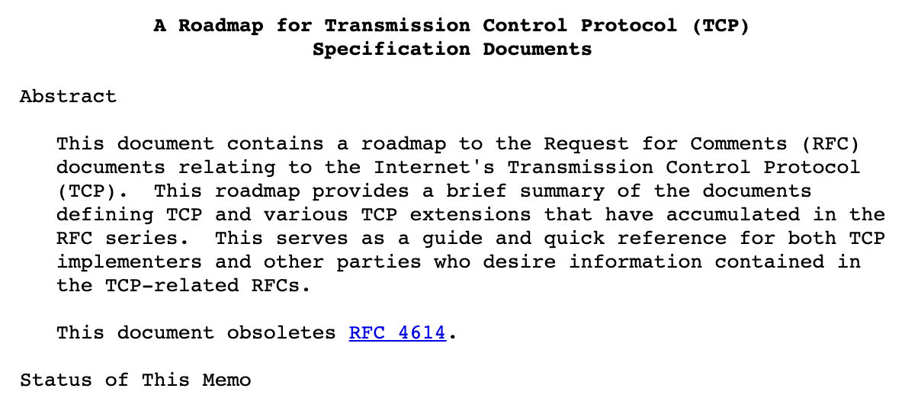
Protocol Reverse Engineering
Notes:
In a common procedure of software development, we implement a protocol according to its specification. The specification is often written in a natural language.
In this work, we try to infer formal or mathematical protocol format from the source code. So, it is a kind of protocol reverse engineering.
A formal protocol format includes two parts, syntax and semantics.
The syntax of a protocol format is often written in a grammar and describes the structure of a network message.
For instance, a TCP message consists of a Header field and a Data field. And the Header field can be further split into smaller fields.
The semantics describes the constraints of one or multiple fields. For instance, this formula describes the semantics that the value of the HeaderLen field equals the length of the Header field.
The formal format can enable many automated security analysis, such as fuzzing and network traffic auditing.
However, it is hard to automate these security applications using the informal documents in a natural language.
So, even we have a document of the specification and the source code, it is still necessary to infer the formal specification, including the formal format.

Slide 3
Protocol Reverse Engineering
TCP →
Header →
…
Header Data
Src Dest … HeaderLen …
…
Syntax in BNF
Format Syntax in BNF
sizeof(Header) = HeaderLen
Semantics in FOL
Notes:
In a common procedure of software development, we implement a protocol according to its specification. The specification is often written in a natural language.
In this work, we try to infer formal or mathematical protocol format from the source code. So, it is a kind of protocol reverse engineering.
A formal protocol format includes two parts, syntax and semantics.
The syntax of a protocol format is often written in a grammar and describes the structure of a network message.
For instance, a TCP message consists of a Header field and a Data field. And the Header field can be further split into smaller fields.
The semantics describes the constraints of one or multiple fields. For instance, this formula describes the semantics that the value of the HeaderLen field equals the length of the Header field.
The formal format can enable many automated security analysis, such as fuzzing and network traffic auditing.
However, it is hard to automate these security applications using the informal documents in a natural language.
So, even we have a document of the specification and the source code, it is still necessary to infer the formal specification, including the formal format.

Slide 4

Protocol Reverse Engineering
Automated Security Analysis
protocol fuzzing, network traffic auditing, differential analysis, verification, …
TCP →
Header →
…
Header Data
Src Dest … HeaderLen …
…
Syntax in BNF
Format Syntax in BNF
sizeof(Header) = HeaderLen
Semantics in FOL
Notes:
In a common procedure of software development, we implement a protocol according to its specification. The specification is often written in a natural language.
In this work, we try to infer formal or mathematical protocol format from the source code. So, it is a kind of protocol reverse engineering.
A formal protocol format includes two parts, syntax and semantics.
The syntax of a protocol format is often written in a grammar and describes the structure of a network message.
For instance, a TCP message consists of a Header field and a Data field. And the Header field can be further split into smaller fields.
The semantics describes the constraints of one or multiple fields. For instance, this formula describes the semantics that the value of the HeaderLen field equals the length of the Header field.
The formal format can enable many automated security analysis, such as fuzzing and network traffic auditing.
However, it is hard to automate these security applications using the informal documents in a natural language.
So, even we have a document of the specification and the source code, it is still necessary to infer the formal specification, including the formal format.

Slide 5

Protocol Reverse Engineering
Automated Security Analysis
protocol fuzzing, network traffic auditing, differential analysis, verification, …
TCP →
Header →
…
Header Data
Src Dest … HeaderLen …
…
Syntax in BNF
Format Syntax in BNF
sizeof(Header) = HeaderLen
Semantics in FOL
Notes:
In a common procedure of software development, we implement a protocol according to its specification. The specification is often written in a natural language.
In this work, we try to infer formal or mathematical protocol format from the source code. So, it is a kind of protocol reverse engineering.
A formal protocol format includes two parts, syntax and semantics.
The syntax of a protocol format is often written in a grammar and describes the structure of a network message.
For instance, a TCP message consists of a Header field and a Data field. And the Header field can be further split into smaller fields.
The semantics describes the constraints of one or multiple fields. For instance, this formula describes the semantics that the value of the HeaderLen field equals the length of the Header field.
The formal format can enable many automated security analysis, such as fuzzing and network traffic auditing.
However, it is hard to automate these security applications using the informal documents in a natural language.
So, even we have a document of the specification and the source code, it is still necessary to infer the formal specification, including the formal format.

Slide 6










Application I: Network Traffic Auditing
Smart Home
Server
Notes:
For example, let us assume that an attacker tries to send a flood of osdp traffic to attack server.
Although the server uses Wireshark and succeeds in auditing the unusual network traffic,
it shows only the raw bytes of the messages. So, it is hard to analyze the traffic.
Our work infers the protocol format from osdp’s implementation
The formal format lets us automatically generate a wireshark plugin to support this protocol.
After using the plugin, wireshark shows detailed components of the messages. It then becomes easy to analyze the traffic

Slide 7
Application I: Network Traffic Auditing
A Flood of OSDP Traffic
Smart Home
Server
Notes:
For example, let us assume that an attacker tries to send a flood of osdp traffic to attack server.
Although the server uses Wireshark and succeeds in auditing the unusual network traffic,
it shows only the raw bytes of the messages. So, it is hard to analyze the traffic.
Our work infers the protocol format from osdp’s implementation
The formal format lets us automatically generate a wireshark plugin to support this protocol.
After using the plugin, wireshark shows detailed components of the messages. It then becomes easy to analyze the traffic

Slide 8
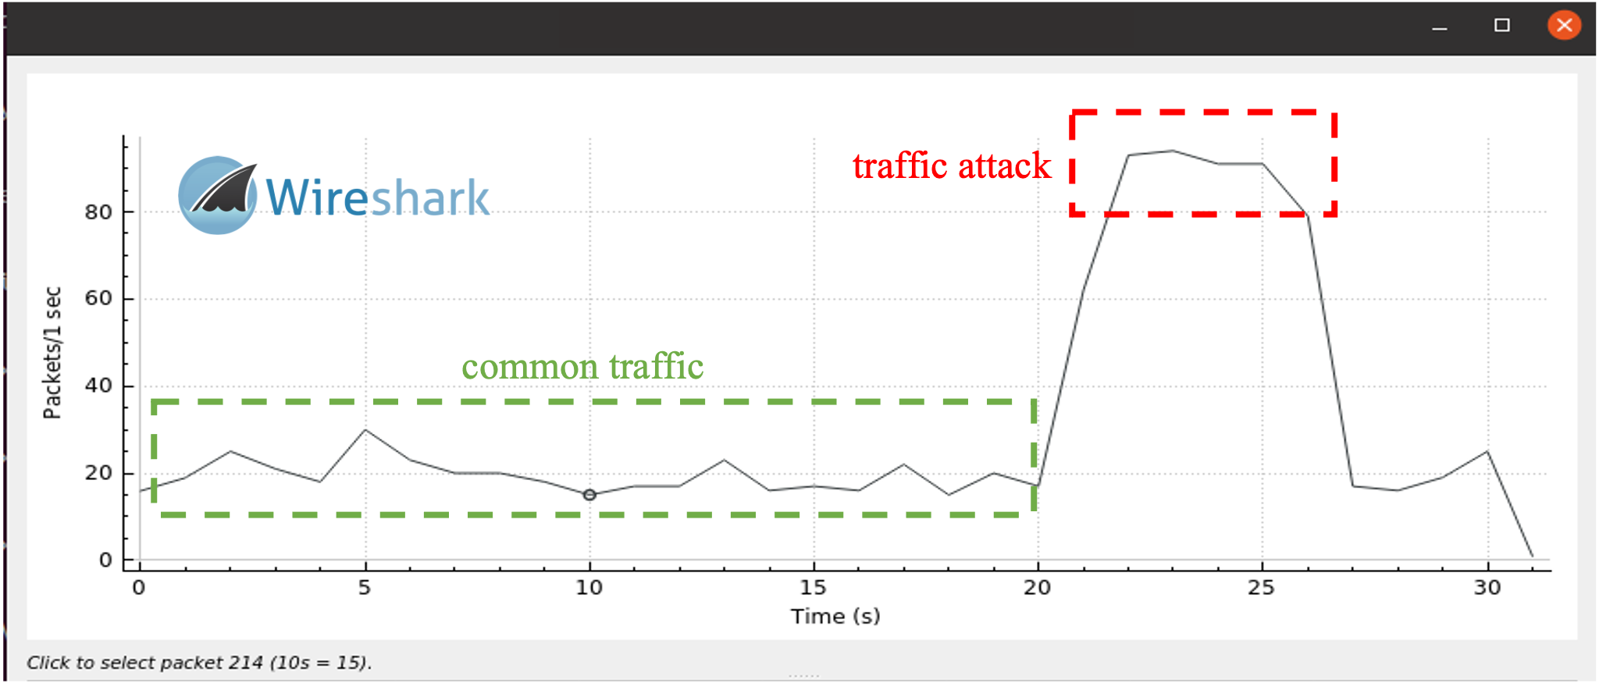

Application I: Network Traffic Auditing
A Flood of OSDP Traffic
Smart Home
Server
Wireshark
Notes:
For example, let us assume that an attacker tries to send a flood of osdp traffic to attack server.
Although the server uses Wireshark and succeeds in auditing the unusual network traffic,
it shows only the raw bytes of the messages. So, it is hard to analyze the traffic.
Our work infers the protocol format from osdp’s implementation
The formal format lets us automatically generate a wireshark plugin to support this protocol.
After using the plugin, wireshark shows detailed components of the messages. It then becomes easy to analyze the traffic

Slide 9
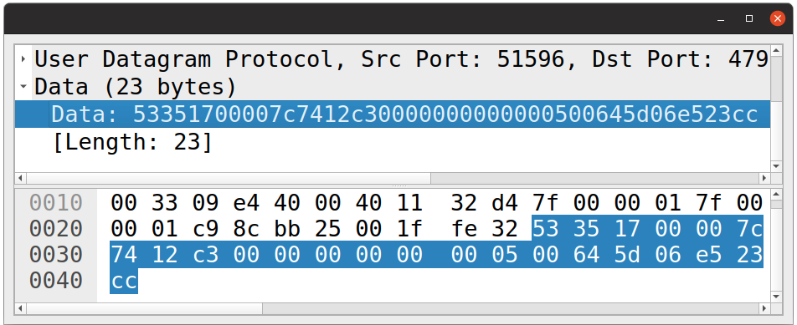
Application I: Network Traffic Auditing
A Flood of OSDP Traffic
Smart Home
Server
Wireshark
Notes:
For example, let us assume that an attacker tries to send a flood of osdp traffic to attack server.
Although the server uses Wireshark and succeeds in auditing the unusual network traffic,
it shows only the raw bytes of the messages. So, it is hard to analyze the traffic.
Our work infers the protocol format from osdp’s implementation
The formal format lets us automatically generate a wireshark plugin to support this protocol.
After using the plugin, wireshark shows detailed components of the messages. It then becomes easy to analyze the traffic

Slide 10
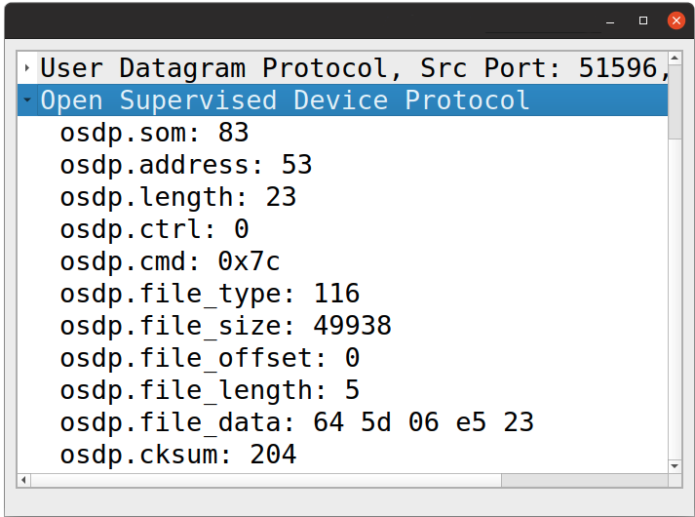

Application I: Network Traffic Auditing
A Flood of OSDP Traffic
Smart Home
Server
Wireshark
Notes:
For example, let us assume that an attacker tries to send a flood of osdp traffic to attack server.
Although the server uses Wireshark and succeeds in auditing the unusual network traffic,
it shows only the raw bytes of the messages. So, it is hard to analyze the traffic.
Our work infers the protocol format from osdp’s implementation
The formal format lets us automatically generate a wireshark plugin to support this protocol.
After using the plugin, wireshark shows detailed components of the messages. It then becomes easy to analyze the traffic

Slide 11
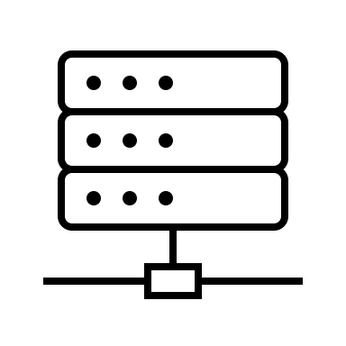



Application II: Network Fuzzing (NetLifter@CCS’23)
Protocol Packets/Message
Network Server
Bug Reports
Notes:
The other application of our work is protocol fuzzing.
To fuzz a protocol, a fuzzer sends random packets to the server.
However, a network server often contains many checks to drop invalid packets.
If the fuzzer only uses random packers, many of them will be dropped, and we cannot deeply test the server.
With the formats inferred by our approach, we can avoid generating a large number of invalid packets. Thus, we can deeply test a network server.
3min

Slide 12
Application II: Network Fuzzing (NetLifter@CCS’23)
Protocol Packets/Message
Network Server
Bug Reports
Drop Invalid Packets
if (packet[0] != packet_length) {
return ERROR;
}
…… /* all business logics */
Notes:
The other application of our work is protocol fuzzing.
To fuzz a protocol, a fuzzer sends random packets to the server.
However, a network server often contains many checks to drop invalid packets.
If the fuzzer only uses random packers, many of them will be dropped, and we cannot deeply test the server.
With the formats inferred by our approach, we can avoid generating a large number of invalid packets. Thus, we can deeply test a network server.
3min

Slide 13
Application II: Network Fuzzing (NetLifter@CCS’23)
Protocol Packets/Message
Network Server
Bug Reports
Drop Invalid Packets
Using format to avoid generating a large number of invalid packets
if (packet[0] != packet_length) {
return ERROR;
}
…… /* all business logics */
Notes:
The other application of our work is protocol fuzzing.
To fuzz a protocol, a fuzzer sends random packets to the server.
However, a network server often contains many checks to drop invalid packets.
If the fuzzer only uses random packers, many of them will be dropped, and we cannot deeply test the server.
With the formats inferred by our approach, we can avoid generating a large number of invalid packets. Thus, we can deeply test a network server.
3min

Slide 14
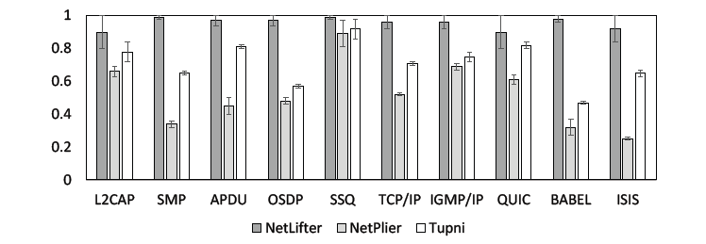
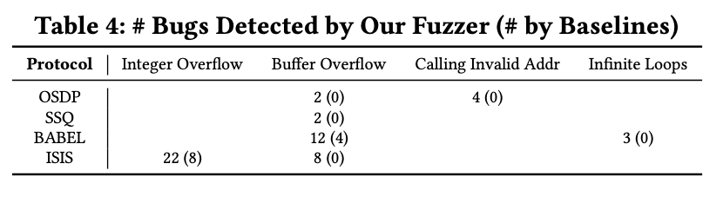
Application II: Network Fuzzing (NetLifter@CCS’23)
20% ~ 260% improvement
Branch coverage normalized to 1.
53 zero-days, including CVEs
Notes:
According to our experiments, using the protocol formats inferred by our approach to guide fuzzing improves the branch coverage of protocol fuzzing.
and help us find 53 zero-day bugs, including integer overflow, buffer overflow, calling invalid address, and infinite loops.
3min30s

Slide 15


Application III: ParDiff@OOPSLA24 - parser differential analysis
Discover logical bugs in network protocol parsers
Logical bugs: missing- and incorrect-implementations of protocol format specifications
Basic idea
Step I. Lifted constrained BNFs ===> Symbolic Finite Automata
Repo - I
SFA- I
Repo - II
SFA- II
Notes:
To address all the issues, we propose ParDiff, a novel static differential analysis approach that can discover logical bugs in network protocol parsers.
Logical bugs include both missing- and mis-implementations of protocol format specifications.
The basic idea is first abstracting low-level protocol implementations to a high-level and unified representation, here we introduce a finite-state machine (FSM) that characterizes the message formats, we will discuss the details later in examples.
why abstract? Different programming styles, different structures…

Slide 16
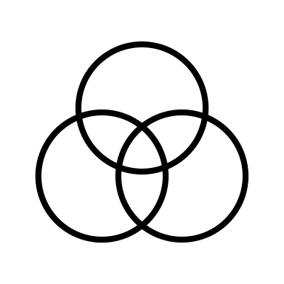
Application III: ParDiff@OOPSLA24 - parser differential analysis
Discover logical bugs in network protocol parsers
Logical bugs: missing- and incorrect-implementations of protocol format specifications
Basic idea
Step II. Find diffs of SFAs via synchronized bi-simulation
Repo - I
SFA- I
Repo - II
SFA- II
diffs
Notes:
Then we precisely compare the two abstractions abstracted from two implementations in a fine-grained way, to find differences.

Slide 17

Application III: ParDiff@OOPSLA24 - parser differential analysis
Discover logical bugs in network protocol parsers
Logical bugs: missing- and incorrect-implementations of protocol format specifications
Basic idea
Step III. Precisely pin-point buggy statement from bi-simulation traces
Repo - I
SFA- I
Repo - II
SFA- II
diffs
bug localization
bug reports
Found 41 logical bugs in mature real-world protocol repos
Notes:
The identified differences are then used for bug localization. For each bug, we generate bug report and send to the developers.

Slide 18
Existing Works for (Protocol) Format Reverse Engineering
Source Code Analysis
Dynamic
Analysis
Static
Analysis
Binary Code Analysis
Notes:
There have been many works on protocol reverse engineering. Why do we create a new one?
Most existing works are dynamic program analysis, either working on source code or binary code.
They depend on a few network messages to infer protocol formats. The key problem if the inputs do not cover some format, we will miss the format.
There are also a few static analysis that works on binary code and is not precise enough.
Our approach is in another dimension. It is a static analysis works on source code. The motivation is simple. That is, although the source code of some protocols are available, formal formats are not available. Many previous works still rely on manual efforts to build the formats. Our work can replace such manual efforts.
Inferring protocol formats, as discussed before, also has many applications.
Unlike dynamic analysis, static analysis has a high coverage, because it does not rely on any inputs. Source code also contains rich code information to help us infer formats.
The challenges we try to address is to achieve high precision, because static analysis is often not precise due to approximation

Slide 19
Existing Works for (Protocol) Format Reverse Engineering
Source Code Analysis
Gopinath et al FSE’20
Hoschele and Zeller ASE’16
…
Dynamic
Analysis
Static
Analysis
AutoFormat, Tupni, Polyglot,
Reformat, Dispatcher, …
Most existing works for network/file
formats are dynamic program analysis
Binary Code Analysis
Notes:
There have been many works on protocol reverse engineering. Why do we create a new one?
Most existing works are dynamic program analysis, either working on source code or binary code.
They depend on a few network messages to infer protocol formats. The key problem if the inputs do not cover some format, we will miss the format.
There are also a few static analysis that works on binary code and is not precise enough.
Our approach is in another dimension. It is a static analysis works on source code. The motivation is simple. That is, although the source code of some protocols are available, formal formats are not available. Many previous works still rely on manual efforts to build the formats. Our work can replace such manual efforts.
Inferring protocol formats, as discussed before, also has many applications.
Unlike dynamic analysis, static analysis has a high coverage, because it does not rely on any inputs. Source code also contains rich code information to help us infer formats.
The challenges we try to address is to achieve high precision, because static analysis is often not precise due to approximation

Slide 20
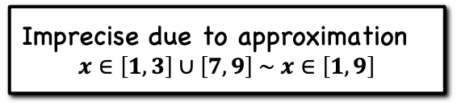
Existing Works for Format Reverse Engineering
Source Code Analysis
Gopinath et al FSE’20
Hoschele and Zeller ASE’16
…
Dynamic
Analysis
Static
Analysis
AutoFormat, Tupni, Polyglot,
Reformat, Dispatcher, …
Lim et al WCRE’06
…
Most existing works for network/file
formats are dynamic program analysis
Imprecise due to approximation
$$x∈\left[1, 3\right]∪\left[7, 9\right] \sim x∈\left[1, 9\right]$$
Binary Code Analysis
Notes:
There have been many works on protocol reverse engineering. Why do we create a new one?
Most existing works are dynamic program analysis, either working on source code or binary code.
They depend on a few network messages to infer protocol formats. The key problem if the inputs do not cover some format, we will miss the format.
There are also a few static analysis that works on binary code and is not precise enough.
Our approach is in another dimension. It is a static analysis works on source code. The motivation is simple. That is, although the source code of some protocols are available, formal formats are not available. Many previous works still rely on manual efforts to build the formats. Our work can replace such manual efforts.
Inferring protocol formats, as discussed before, also has many applications.
Unlike dynamic analysis, static analysis has a high coverage, because it does not rely on any inputs. Source code also contains rich code information to help us infer formats.
The challenges we try to address is to achieve high precision, because static analysis is often not precise due to approximation

Slide 21

Existing Works for Format Reverse Engineering
Source Code Analysis
Gopinath et al FSE’20
Hoschele and Zeller ASE’16
…
Dynamic
Analysis
Static
Analysis
AutoFormat, Tupni, Polyglot,
Reformat, Dispatcher, …
Lim et al WCRE’06
…
Most existing works for network/file
formats are dynamic program analysis
Imprecise due to approximation
$$x∈\left[1, 3\right]∪\left[7, 9\right] \sim x∈\left[1, 9\right]$$
Binary Code Analysis
Notes:
There have been many works on protocol reverse engineering. Why do we create a new one?
Most existing works are dynamic program analysis, either working on source code or binary code.
They depend on a few network messages to infer protocol formats. The key problem if the inputs do not cover some format, we will miss the format.
There are also a few static analysis that works on binary code and is not precise enough.
Our approach is in another dimension. It is a static analysis works on source code. The motivation is simple. That is, although the source code of some protocols are available, formal formats are not available. Many previous works still rely on manual efforts to build the formats. Our work can replace such manual efforts.
Inferring protocol formats, as discussed before, also has many applications.
Unlike dynamic analysis, static analysis has a high coverage, because it does not rely on any inputs. Source code also contains rich code information to help us infer formats.
The challenges we try to address is to achieve high precision, because static analysis is often not precise due to approximation

Slide 22
Existing Works for Format Reverse Engineering
Source Code Analysis
Motivation
  Formal formats are not available
  Many works like FrameShifter [Security’ 22] still rely on manually built formats
Gopinath et al FSE’20
Hoschele and Zeller ASE’16
…
Dynamic
Analysis
Static
Analysis
AutoFormat, Tupni, Polyglot,
Reformat, Dispatcher, …
Lim et al WCRE’06
…
Most existing works for network/file
formats are dynamic program analysis
Imprecise due to approximation
$$x∈\left[1, 3\right]∪\left[7, 9\right] \sim x∈\left[1, 9\right]$$
Binary Code Analysis
Notes:
There have been many works on protocol reverse engineering. Why do we create a new one?
Most existing works are dynamic program analysis, either working on source code or binary code.
They depend on a few network messages to infer protocol formats. The key problem if the inputs do not cover some format, we will miss the format.
There are also a few static analysis that works on binary code and is not precise enough.
Our approach is in another dimension. It is a static analysis works on source code. The motivation is simple. That is, although the source code of some protocols are available, formal formats are not available. Many previous works still rely on manual efforts to build the formats. Our work can replace such manual efforts.
Inferring protocol formats, as discussed before, also has many applications.
Unlike dynamic analysis, static analysis has a high coverage, because it does not rely on any inputs. Source code also contains rich code information to help us infer formats.
The challenges we try to address is to achieve high precision, because static analysis is often not precise due to approximation

Slide 23
Existing Works for Format Reverse Engineering
Source Code Analysis
Motivation
  Formal formats are not available
  Many works like FrameShifter [Security’ 22] still rely on manually built formats
Applications
  Protocol fuzzing
  Traffic Auditing
  …
Gopinath et al FSE’20
Hoschele and Zeller ASE’16
…
Dynamic
Analysis
Static
Analysis
AutoFormat, Tupni, Polyglot,
Reformat, Dispatcher, …
Lim et al WCRE’06
…
Most existing works for network/file
formats are dynamic program analysis
Imprecise due to approximation
$$x∈\left[1, 3\right]∪\left[7, 9\right] \sim x∈\left[1, 9\right]$$
Binary Code Analysis
Notes:
There have been many works on protocol reverse engineering. Why do we create a new one?
Most existing works are dynamic program analysis, either working on source code or binary code.
They depend on a few network messages to infer protocol formats. The key problem if the inputs do not cover some format, we will miss the format.
There are also a few static analysis that works on binary code and is not precise enough.
Our approach is in another dimension. It is a static analysis works on source code. The motivation is simple. That is, although the source code of some protocols are available, formal formats are not available. Many previous works still rely on manual efforts to build the formats. Our work can replace such manual efforts.
Inferring protocol formats, as discussed before, also has many applications.
Unlike dynamic analysis, static analysis has a high coverage, because it does not rely on any inputs. Source code also contains rich code information to help us infer formats.
The challenges we try to address is to achieve high precision, because static analysis is often not precise due to approximation

Slide 24
Existing Works for Format Reverse Engineering
Source Code Analysis
Motivation
  Formal formats are not available
  Many works like FrameShifter [Security’ 22] still rely on manually built formats
Applications
  Protocol fuzzing
  Traffic Auditing
  …
Advantages
  High coverage
  It does not rely on any inputs
  Rich code information
Gopinath et al FSE’20
Hoschele and Zeller ASE’16
…
Dynamic
Analysis
Static
Analysis
AutoFormat, Tupni, Polyglot,
Reformat, Dispatcher, …
Lim et al WCRE’06
…
Most existing works for network/file
formats are dynamic program analysis
Imprecise due to approximation
$$x∈\left[1, 3\right]∪\left[7, 9\right] \sim x∈\left[1, 9\right]$$
Binary Code Analysis
Notes:
There have been many works on protocol reverse engineering. Why do we create a new one?
Most existing works are dynamic program analysis, either working on source code or binary code.
They depend on a few network messages to infer protocol formats. The key problem if the inputs do not cover some format, we will miss the format.
There are also a few static analysis that works on binary code and is not precise enough.
Our approach is in another dimension. It is a static analysis works on source code. The motivation is simple. That is, although the source code of some protocols are available, formal formats are not available. Many previous works still rely on manual efforts to build the formats. Our work can replace such manual efforts.
Inferring protocol formats, as discussed before, also has many applications.
Unlike dynamic analysis, static analysis has a high coverage, because it does not rely on any inputs. Source code also contains rich code information to help us infer formats.
The challenges we try to address is to achieve high precision, because static analysis is often not precise due to approximation

Slide 25
Existing Works for Format Reverse Engineering
Source Code Analysis
Motivation
  Formal formats are not available
  Many works like FrameShifter [Security’ 22] still rely on manually built formats
Applications
  Protocol fuzzing
  Traffic Auditing
  …
Advantages
  High coverage
  It does not rely on any inputs
  Rich code information
Challenges
  To achieve high precision due to approximations in static analysis
Gopinath et al FSE’20
Hoschele and Zeller ASE’16
…
Dynamic
Analysis
Static
Analysis
AutoFormat, Tupni, Polyglot,
Reformat, Dispatcher, …
Lim et al WCRE’06
…
Most existing works for network/file
formats are dynamic program analysis
Imprecise due to approximation
$$x∈\left[1, 3\right]∪\left[7, 9\right] \sim x∈\left[1, 9\right]$$
Binary Code Analysis
Notes:
There have been many works on protocol reverse engineering. Why do we create a new one?
Most existing works are dynamic program analysis, either working on source code or binary code.
They depend on a few network messages to infer protocol formats. The key problem if the inputs do not cover some format, we will miss the format.
There are also a few static analysis that works on binary code and is not precise enough.
Our approach is in another dimension. It is a static analysis works on source code. The motivation is simple. That is, although the source code of some protocols are available, formal formats are not available. Many previous works still rely on manual efforts to build the formats. Our work can replace such manual efforts.
Inferring protocol formats, as discussed before, also has many applications.
Unlike dynamic analysis, static analysis has a high coverage, because it does not rely on any inputs. Source code also contains rich code information to help us infer formats.
The challenges we try to address is to achieve high precision, because static analysis is often not precise due to approximation

Slide 26
Observation - I
Observation 1: Path condition implies both syntax and semantics of protocol formats
Notes:
Our approach follows two simple observations. The first one is that path condition in a program implies both syntax and semantics of protocol formats.
Syntax means endianness and field boundaries and answers the question : how can a message be partitioned into multiple fields.
Semantics include low level semantics and high level semantics. low level semantics are first order logic constraints among fields.
high level semantics are field names that can be understood by human beings.
For example, this code computes the value length using the first two bytes of a packet and then test if length equals 10.
The path condition of a success path is like this.
We can infer from the path condition that, it uses little endianness, because the order of the bytes. The first two bytes form a field because they are used in the same value.
The path condition itself is a low-level semantics meaning that its value must be 10.
From the code, we can also infer a high-level semantics that the field has a name, which is length according to the variable name in the code.

Slide 27
Observation - I
Observation 1: Path condition implies both syntax and semantics of protocol formats
Syntax
Endianness, Field Boundaries
How can a message be partitioned
into multiple fields?
Notes:
Our approach follows two simple observations. The first one is that path condition in a program implies both syntax and semantics of protocol formats.
Syntax means endianness and field boundaries and answers the question : how can a message be partitioned into multiple fields.
Semantics include low level semantics and high level semantics. low level semantics are first order logic constraints among fields.
high level semantics are field names that can be understood by human beings.
For example, this code computes the value length using the first two bytes of a packet and then test if length equals 10.
The path condition of a success path is like this.
We can infer from the path condition that, it uses little endianness, because the order of the bytes. The first two bytes form a field because they are used in the same value.
The path condition itself is a low-level semantics meaning that its value must be 10.
From the code, we can also infer a high-level semantics that the field has a name, which is length according to the variable name in the code.

Slide 28
Observation - I
Observation 1: Path condition implies both syntax and semantics of protocol formats
Syntax
Semantics
Endianness, Field Boundaries
How can a message be partitioned
into multiple fields?
Low Level
Single Field Constraints
Cross Field Constraints
High Level
Field names: does a field
represent length?
Notes:
Our approach follows two simple observations. The first one is that path condition in a program implies both syntax and semantics of protocol formats.
Syntax means endianness and field boundaries and answers the question : how can a message be partitioned into multiple fields.
Semantics include low level semantics and high level semantics. low level semantics are first order logic constraints among fields.
high level semantics are field names that can be understood by human beings.
For example, this code computes the value length using the first two bytes of a packet and then test if length equals 10.
The path condition of a success path is like this.
We can infer from the path condition that, it uses little endianness, because the order of the bytes. The first two bytes form a field because they are used in the same value.
The path condition itself is a low-level semantics meaning that its value must be 10.
From the code, we can also infer a high-level semantics that the field has a name, which is length according to the variable name in the code.

Slide 29
Observation - I
Observation 1: Path condition implies both syntax and semantics of protocol formats
Syntax
Semantics
Endianness, Field Boundaries
How can a message be partitioned
into multiple fields?
Low Level
Single Field Constraints
Cross Field Constraints
High Level
Field names: does a field
represent length?
int16_t length = pkt[1] << 8 | pkt[0];
if (length != 10) return ERROR;
return SUCCESS;
Notes:
Our approach follows two simple observations. The first one is that path condition in a program implies both syntax and semantics of protocol formats.
Syntax means endianness and field boundaries and answers the question : how can a message be partitioned into multiple fields.
Semantics include low level semantics and high level semantics. low level semantics are first order logic constraints among fields.
high level semantics are field names that can be understood by human beings.
For example, this code computes the value length using the first two bytes of a packet and then test if length equals 10.
The path condition of a success path is like this.
We can infer from the path condition that, it uses little endianness, because the order of the bytes. The first two bytes form a field because they are used in the same value.
The path condition itself is a low-level semantics meaning that its value must be 10.
From the code, we can also infer a high-level semantics that the field has a name, which is length according to the variable name in the code.

Slide 30
Observation - I
Observation 1: Path condition implies both syntax and semantics of protocol formats
Syntax
Semantics
Endianness, Field Boundaries
How can a message be partitioned
into multiple fields?
Low Level
Single Field Constraints
Cross Field Constraints
High Level
Field names: does a field
represent length?
int16_t length = pkt[1] << 8 | pkt[0];
if (length != 10) return ERROR;
return SUCCESS;
Path Condition: pkt[1]pkt[0] == 10
Notes:
Our approach follows two simple observations. The first one is that path condition in a program implies both syntax and semantics of protocol formats.
Syntax means endianness and field boundaries and answers the question : how can a message be partitioned into multiple fields.
Semantics include low level semantics and high level semantics. low level semantics are first order logic constraints among fields.
high level semantics are field names that can be understood by human beings.
For example, this code computes the value length using the first two bytes of a packet and then test if length equals 10.
The path condition of a success path is like this.
We can infer from the path condition that, it uses little endianness, because the order of the bytes. The first two bytes form a field because they are used in the same value.
The path condition itself is a low-level semantics meaning that its value must be 10.
From the code, we can also infer a high-level semantics that the field has a name, which is length according to the variable name in the code.

Slide 31
Observation - I
Observation 1: Path condition implies both syntax and semantics of protocol formats
Syntax
Semantics
Endianness, Field Boundaries
How can a message be partitioned
into multiple fields?
Low Level
Single Field Constraints
Cross Field Constraints
High Level
Field names: does a field
represent length?
int16_t length = pkt[1] << 8 | pkt[0];
if (length != 10) return ERROR;
return SUCCESS;
Path Condition: pkt[1]pkt[0] == 10
Syntax: little endianness, first two bytes is a field
Notes:
Our approach follows two simple observations. The first one is that path condition in a program implies both syntax and semantics of protocol formats.
Syntax means endianness and field boundaries and answers the question : how can a message be partitioned into multiple fields.
Semantics include low level semantics and high level semantics. low level semantics are first order logic constraints among fields.
high level semantics are field names that can be understood by human beings.
For example, this code computes the value length using the first two bytes of a packet and then test if length equals 10.
The path condition of a success path is like this.
We can infer from the path condition that, it uses little endianness, because the order of the bytes. The first two bytes form a field because they are used in the same value.
The path condition itself is a low-level semantics meaning that its value must be 10.
From the code, we can also infer a high-level semantics that the field has a name, which is length according to the variable name in the code.

Slide 32
Observation - I
Observation 1: Path condition implies both syntax and semantics of protocol formats
Syntax
Semantics
Endianness, Field Boundaries
How can a message be partitioned
into multiple fields?
Low Level
Single Field Constraints
Cross Field Constraints
High Level
Field names: does a field
represent length?
int16_t length = pkt[1] << 8 | pkt[0];
if (length != 10) return ERROR;
return SUCCESS;
Path Condition: pkt[1]pkt[0] == 10
Syntax: little endianness, first two bytes is a field
Semantics: the first field is length, which must equal 10
Notes:
Our approach follows two simple observations. The first one is that path condition in a program implies both syntax and semantics of protocol formats.
Syntax means endianness and field boundaries and answers the question : how can a message be partitioned into multiple fields.
Semantics include low level semantics and high level semantics. low level semantics are first order logic constraints among fields.
high level semantics are field names that can be understood by human beings.
For example, this code computes the value length using the first two bytes of a packet and then test if length equals 10.
The path condition of a success path is like this.
We can infer from the path condition that, it uses little endianness, because the order of the bytes. The first two bytes form a field because they are used in the same value.
The path condition itself is a low-level semantics meaning that its value must be 10.
From the code, we can also infer a high-level semantics that the field has a name, which is length according to the variable name in the code.

Slide 33
Observation - II
Observation 2: Path condition can be easily transformed to a BNF-style protocol format
TCP →
Header →
…
Header Data
Src Dest … HeaderLen …
…
Format Syntax in BNF
Notes:
The second observation is that path condition can be easily transformed a BNF style grammar that gradually split a message into multiple fields.
Let us consider this simple protocol parser. The input is a network packet, which is a byte array.
The second line reads the first byte into the variable code.
When code is zero, ctrl equals the 2nd byte plus 1, otherwise, ctrl equals the 2nd byte minus 1.
Finally, an assertion requires the value of ctrl should be zero.
The program has two paths, and the whole path condition is a disjunction of two individual path conditions.
The first part means that the network packet consists of two bytes and should satisfy corresponding constraints.
The second part means the same except that the condition is different.
Finally, the disjunction can be interpreted into an alternation in the grammar. 7.5min

Slide 34
Observation - II
Observation 2: Path condition can be easily transformed to a BNF-style protocol format
1.
2.
3.
4.
5.
6.
7.
8.
void parse_packet(byte *pkt) {
byte code = pkt[0];
if (code == 0)
ctrl = pkt[1] + 1;
else
ctrl = pkt[1] – 1;
assert(ctrl == 0);
}
Notes:
The second observation is that path condition can be easily transformed a BNF style grammar that gradually split a message into multiple fields.
Let us consider this simple protocol parser. The input is a network packet, which is a byte array.
The second line reads the first byte into the variable code.
When code is zero, ctrl equals the 2nd byte plus 1, otherwise, ctrl equals the 2nd byte minus 1.
Finally, an assertion requires the value of ctrl should be zero.
The program has two paths, and the whole path condition is a disjunction of two individual path conditions.
The first part means that the network packet consists of two bytes and should satisfy corresponding constraints.
The second part means the same except that the condition is different.
Finally, the disjunction can be interpreted into an alternation in the grammar. 7.5min

Slide 35
Observation - II
Observation 2: Path condition can be easily transformed to a BNF-style protocol format
1.
2.
3.
4.
5.
6.
7.
8.
void parse_packet(byte *pkt) {
byte code = pkt[0];
if (code == 0)
ctrl = pkt[1] + 1;
else
ctrl = pkt[1] – 1;
assert(ctrl == 0);
}
Path Condition:
(pkt[0] = 0 ∧ pkt[1] + 1 = 0) ∨ (pkt[0] ≠ 0 ∧ pkt[1] - 1 = 0)
BNF-Style Format:
Notes:
The second observation is that path condition can be easily transformed a BNF style grammar that gradually split a message into multiple fields.
Let us consider this simple protocol parser. The input is a network packet, which is a byte array.
The second line reads the first byte into the variable code.
When code is zero, ctrl equals the 2nd byte plus 1, otherwise, ctrl equals the 2nd byte minus 1.
Finally, an assertion requires the value of ctrl should be zero.
The program has two paths, and the whole path condition is a disjunction of two individual path conditions.
The first part means that the network packet consists of two bytes and should satisfy corresponding constraints.
The second part means the same except that the condition is different.
Finally, the disjunction can be interpreted into an alternation in the grammar. 7.5min

Slide 36
Observation - II
Observation 2: Path condition can be easily transformed to a BNF-style protocol format
1.
2.
3.
4.
5.
6.
7.
8.
void parse_packet(byte *pkt) {
byte code = pkt[0];
if (code == 0)
ctrl = pkt[1] + 1;
else
ctrl = pkt[1] – 1;
assert(ctrl == 0);
}
Path Condition:
(pkt[0] = 0 ∧ pkt[1] + 1 = 0) ∨ (pkt[0] ≠ 0 ∧ pkt[1] - 1 = 0)
BNF-Style Format:
pkt₁ → pkt[0] pkt[1] ;
assert(pkt[0] = 0)
assert(pkt[1] + 1 = 0)
pkt₂ → pkt[0] pkt[1] ;
assert(pkt[0] = 0)
assert(pkt[1] - 1 = 0)
Notes:
The second observation is that path condition can be easily transformed a BNF style grammar that gradually split a message into multiple fields.
Let us consider this simple protocol parser. The input is a network packet, which is a byte array.
The second line reads the first byte into the variable code.
When code is zero, ctrl equals the 2nd byte plus 1, otherwise, ctrl equals the 2nd byte minus 1.
Finally, an assertion requires the value of ctrl should be zero.
The program has two paths, and the whole path condition is a disjunction of two individual path conditions.
The first part means that the network packet consists of two bytes and should satisfy corresponding constraints.
The second part means the same except that the condition is different.
Finally, the disjunction can be interpreted into an alternation in the grammar. 7.5min

Slide 37
Observation - II
Observation 2: Path condition can be easily transformed to a BNF-style protocol format
1.
2.
3.
4.
5.
6.
7.
8.
void parse_packet(byte *pkt) {
byte code = pkt[0];
if (code == 0)
ctrl = pkt[1] + 1;
else
ctrl = pkt[1] – 1;
assert(ctrl == 0);
}
Path Condition:
(pkt[0] = 0 ∧ pkt[1] + 1 = 0) ∨ (pkt[0] ≠ 0 ∧ pkt[1] - 1 = 0)
BNF-Style Format:
pkt₁ → pkt[0] pkt[1] ;
assert(pkt[0] = 0)
assert(pkt[1] + 1 = 0)
pkt₂ → pkt[0] pkt[1] ;
assert(pkt[0] = 0)
assert(pkt[1] - 1 = 0)
pkt → pkt₁ | pkt₂
Notes:
The second observation is that path condition can be easily transformed a BNF style grammar that gradually split a message into multiple fields.
Let us consider this simple protocol parser. The input is a network packet, which is a byte array.
The second line reads the first byte into the variable code.
When code is zero, ctrl equals the 2nd byte plus 1, otherwise, ctrl equals the 2nd byte minus 1.
Finally, an assertion requires the value of ctrl should be zero.
The program has two paths, and the whole path condition is a disjunction of two individual path conditions.
The first part means that the network packet consists of two bytes and should satisfy corresponding constraints.
The second part means the same except that the condition is different.
Finally, the disjunction can be interpreted into an alternation in the grammar. 7.5min

Slide 38
Observation - II
Observation 2: Path condition can be easily transformed to a BNF-style protocol format
1.
2.
3.
4.
5.
6.
7.
8.
void parse_packet(byte *pkt) {
byte code = pkt[0];
if (code == 0)
ctrl = pkt[1] + 1;
else
ctrl = pkt[1] – 1;
assert(ctrl == 0);
}
Path Condition:
(pkt[0] = 0 ∧ pkt[1] + 1 = 0) ∨ (pkt[0] ≠ 0 ∧ pkt[1] - 1 = 0)
BNF-Style Format:
pkt₁ → pkt[0] pkt[1] ;
assert(pkt[0] = 0)
assert(pkt[1] + 1 = 0)
pkt₂ → pkt[0] pkt[1] ;
assert(pkt[0] = 0)
assert(pkt[1] - 1 = 0)
code
ctrl
pkt → pkt₁ | pkt₂
Notes:
From the code, we can infer the name of each byte.

Slide 39
Observation - II
Observation 2: Path condition can be easily transformed to a BNF-style protocol format
1.
2.
3.
4.
5.
6.
7.
8.
void parse_packet(byte *pkt) {
byte code = pkt[0];
if (code == 0)
ctrl = pkt[1] + 1;
else
ctrl = pkt[1] – 1;
assert(ctrl == 0);
}
Path Condition:
(pkt[0] = 0 ∧ pkt[1] + 1 = 0) ∨ (pkt[0] ≠ 0 ∧ pkt[1] - 1 = 0)
BNF-Style Format:
pkt₁ → code ctrl ;
assert(code = 0)
assert(ctrl + 1 = 0)
pkt₂ → code ctrl ;
assert(code = 0)
assert(ctrl - 1 = 0)
pkt → pkt₁ | pkt₂
Notes:
After replacing each byte with the name, we get the final BNF-style protocol formats, including both the syntax and semantics. 8min

Slide 40
Challenge - I
Challenge 1: Path Explosion
Solution 1: Localized Path Sensitivity
Notes:
Although our observations are very simple, we have to address two challenges in practice.
According to our previous discussion, each path condition implies a possible protocol format.
However, we cannot enumerate all paths and path conditions in a program, because of path explosion.
Our solution is to not enumerate all complete paths in a program but enumerate paths in local regions, which we refer to as the localized path sensitivity.
/// XXX
For instance, this protocol parser firstly parses the first 3 bytes and then the next 3 bytes. It contains 4 if-branches.
If we enumerate all paths, then we have to enumerate 16 paths of length 4.
Our approach splits the code into two parts, the top part and the bottom part, according to data dependency and ctrl dependency in the code.
We then enumerate the 4 paths of length 2 in the top part and, the other 4 paths of length 2 in the bottom.
path conditions of the top part imply the format of the first 3 bytes.
path conditions of the bottom imply the format of the last 3 bytes.
Finally, we connect them to produce the complete format.

Slide 41
Challenge - I
Challenge 1: Path Explosion
Solution 1: Localized Path Sensitivity
void parse(byte *pkt) {
code = pkt[0]; ctrl = pkt[1];
if (code == 0) ctrl = ctrl + 1;
else ctrl = ctrl – 1;
if (ctrl == 0) assert(pkt[2] == 0);
else assert(pkt[2] == 1);
code = pkt[3]; ctrl = pkt[4];
if (code == 0) ctrl = ctrl + 1;
else ctrl = ctrl – 1;
if (ctrl == 0) assert(pkt[5] == 0);
else assert(pkt[5] == 1);
}
pkt[0..2]
pkt[3..5]
Notes:
I will not discuss the details because of time limit. please refer to the paper for details.

Slide 42
Challenge - I
Challenge 1: Path Explosion
Solution 1: Localized Path Sensitivity
void parse(byte *pkt) {
code = pkt[0]; ctrl = pkt[1];
if (code == 0) ctrl = ctrl + 1;
else ctrl = ctrl – 1;
if (ctrl == 0) assert(pkt[2] == 0);
else assert(pkt[2] == 1);
code = pkt[3]; ctrl = pkt[4];
if (code == 0) ctrl = ctrl + 1;
else ctrl = ctrl – 1;
if (ctrl == 0) assert(pkt[5] == 0);
else assert(pkt[5] == 1);
}
Path Reduction:
16 paths of length 4 for pkt[0..5]
=>
4 paths of length 2 for pkt[0..2]
+
4 paths of length 2 for pkt[3..5]
pkt[0..2]
pkt[3..5]
Notes:
I will not discuss the details because of time limit. please refer to the paper for details.

Slide 43
Challenge - I
Challenge 1: Path Explosion
Solution 1: Localized Path Sensitivity
void parse(byte *pkt) {
code = pkt[0]; ctrl = pkt[1];
if (code == 0) ctrl = ctrl + 1;
else ctrl = ctrl – 1;
if (ctrl == 0) assert(pkt[2] == 0);
else assert(pkt[2] == 1);
code = pkt[3]; ctrl = pkt[4];
if (code == 0) ctrl = ctrl + 1;
else ctrl = ctrl – 1;
if (ctrl == 0) assert(pkt[5] == 0);
else assert(pkt[5] == 1);
}
Path Reduction:
16 paths of length 4 for pkt[0..5]
=>
4 paths of length 2 for pkt[0..2]
+
4 paths of length 2 for pkt[3..5]
pkt[0..2]
BNF-Style Formats:
pkt[0..2] → .. | .. | .. | ..
pkt[3..5] → .. | .. | .. | ..
pkt → pkt[0..2] pkt[3..5]
pkt[3..5]
Notes:
I will not discuss the details because of time limit. please refer to the paper for details.

Slide 44
Challenge - I
Challenge 1: Path Explosion
Solution 1: Localized Path Sensitivity
void parse(byte *pkt) {
code = pkt[0]; ctrl = pkt[1];
if (code == 0) ctrl = ctrl + 1;
else ctrl = ctrl – 1;
if (ctrl == 0) assert(pkt[2] == 0);
else assert(pkt[2] == 1);
code = pkt[3]; ctrl = pkt[4];
if (code == 0) ctrl = ctrl + 1;
else ctrl = ctrl – 1;
if (ctrl == 0) assert(pkt[5] == 0);
else assert(pkt[5] == 1);
}
Path Reduction:
16 paths of length 4 for pkt[0..5]
=>
4 paths of length 2 for pkt[0..2]
+
4 paths of length 2 for pkt[3..5]
pkt[0..2]
refer to our paper for details
BNF-Style Formats:
pkt[0..2] → .. | .. | .. | ..
pkt[3..5] → .. | .. | .. | ..
pkt → pkt[0..2] pkt[3..5]
pkt[3..5]
Notes:
I will not discuss the details because of time limit. please refer to the paper for details.

Slide 45
Challenge - II
Challenge 2: Disordered Path Condition
Solution 2: Path Reordering Algorithm
TCP →
Header →
…
Header Data
Src Dest … HeaderLen …
…
Format Syntax in BNF
Notes:
We name the second challenge we have to address is the ”disordered path condition”.
Recall that a BNF-style format specifies a format from the first byte to the last in order.
In previous examples, the path conditions also constrain the network packets in this order. For example, it first constrains the first byte and then the second.

Slide 46
Challenge - II
Challenge 2: Disordered Path Condition
Solution 2: Path Reordering Algorithm
Path Condition:
(pkt[0] = 0 ∧ pkt[1] + 1 = 0) ∨ (pkt[0] ≠ 0 ∧ pkt[1] - 1 = 0)
BNF-Style Format:
pkt₁ → pkt[0] pkt[1] ;
assert(pkt[0] = 0)
assert(pkt[1] + 1 = 0)
pkt₂ → pkt[0] pkt[1] ;
assert(pkt[0] = 0)
assert(pkt[1] - 1 = 0)
pkt → pkt₁ | pkt₂
Notes:
We name the second challenge we have to address is the ”disordered path condition”.
Recall that a BNF-style format specifies a format from the first byte to the last in order.
In previous examples, the path conditions also constrain the network packets in this order. For example, it first constrains the first byte and then the second.

Slide 47
Challenge - II
Challenge 2: Disordered Path Condition
Solution 2: Path Reordering Algorithm
{ (pkt[7] = 0 ∧ pkt[6] + 1 = 0) ∨ (pkt[8] ≠ 0 ∧ pkt[6] - 1 = 0) } ∧ pkt[5] = 0
Notes:
However, in practice, we may compute a path condition that does not follow the order.
In this case, we need to rewrite the path condition before translating it into the BNF-style format.
The basic idea is that ”a and b” equals ”b and a”. For instance, in this example, we can switch this two conditions ,….
After rewriting, we can easily transform it into the BNF-style format by interpreting conjunction to concatenation in BNF, and disjunction to alternation in BNF.

Slide 48
Challenge - II
Challenge 2: Disordered Path Condition
Solution 2: Path Reordering Algorithm
{ (pkt[7] = 0 ∧ pkt[6] + 1 = 0) ∨ (pkt[8] ≠ 0 ∧ pkt[6] - 1 = 0) } ∧ pkt[5] = 0
Notes:
However, in practice, we may compute a path condition that does not follow the order.
In this case, we need to rewrite the path condition before translating it into the BNF-style format.
The basic idea is that ”a and b” equals ”b and a”. For instance, in this example, we can switch this two conditions ,….
After rewriting, we can easily transform it into the BNF-style format by interpreting conjunction to concatenation in BNF, and disjunction to alternation in BNF.

Slide 49
Challenge - II
Challenge 2: Disordered Path Condition
Solution 2: Path Reordering Algorithm
{ (pkt[7] = 0 ∧ pkt[6] + 1 = 0) ∨ (pkt[8] ≠ 0 ∧ pkt[6] - 1 = 0) } ∧ pkt[5] = 0
Notes:
However, in practice, we may compute a path condition that does not follow the order.
In this case, we need to rewrite the path condition before translating it into the BNF-style format.
The basic idea is that ”a and b” equals ”b and a”. For instance, in this example, we can switch this two conditions ,….
After rewriting, we can easily transform it into the BNF-style format by interpreting conjunction to concatenation in BNF, and disjunction to alternation in BNF.

Slide 50
Challenge - II
Challenge 2: Disordered Path Condition
Solution 2: Path Reordering Algorithm
{ (pkt[7] = 0 ∧ pkt[6] + 1 = 0) ∨ (pkt[8] ≠ 0 ∧ pkt[6] - 1 = 0) } ∧ pkt[5] = 0
pkt[5] = 0 ∧ { (pkt[6] + 1 = 0 ∧ pkt[7] = 0) ∨ (pkt[6] - 1 = 0 ∧ pkt[8] ≠ 0) }
Notes:
However, in practice, we may compute a path condition that does not follow the order.
In this case, we need to rewrite the path condition before translating it into the BNF-style format.
The basic idea is that ”a and b” equals ”b and a”. For instance, in this example, we can switch this two conditions ,….
After rewriting, we can easily transform it into the BNF-style format by interpreting conjunction to concatenation in BNF, and disjunction to alternation in BNF.

Slide 51
Challenge - II
Challenge 2: Disordered Path Condition
Solution 2: Path Reordering Algorithm
{ (pkt[7] = 0 ∧ pkt[6] + 1 = 0) ∨ (pkt[8] ≠ 0 ∧ pkt[6] - 1 = 0) } ∧ pkt[5] = 0
pkt[5] = 0 ∧ { (pkt[6] + 1 = 0 ∧ pkt[7] = 0) ∨ (pkt[6] - 1 = 0 ∧ pkt[8] ≠ 0) }
X → pkt[6] pkt[7]; Y → pkt[6] pkt[7] pkt[8];
assert(pkt[6] + 1 = 0) assert(pkt[6] - 1 = 0)
assert(pkt[7] = 0) assert(pkt[8] ≠ 0)
pkt → pkt[0..4] pkt[5] (X | Y);
assert(pkt[5] = 0)
Notes:
However, in practice, we may compute a path condition that does not follow the order.
In this case, we need to rewrite the path condition before translating it into the BNF-style format.
The basic idea is that ”a and b” equals ”b and a”. For instance, in this example, we can switch this two conditions ,….
After rewriting, we can easily transform it into the BNF-style format by interpreting conjunction to concatenation in BNF, and disjunction to alternation in BNF.

Slide 52
Challenge - II
Challenge 2: Disordered Path Condition
Solution 2: Path Reordering Algorithm
{ (pkt[7] = 0 ∧ pkt[6] + 1 = 0) ∨ (pkt[8] ≠ 0 ∧ pkt[6] - 1 = 0) } ∧ pkt[5] = 0
refer to our paper for details
pkt[5] = 0 ∧ { (pkt[6] + 1 = 0 ∧ pkt[7] = 0) ∨ (pkt[6] - 1 = 0 ∧ pkt[8] ≠ 0) }
pkt → pkt[0..4] pkt[5] (X | Y);
assert(pkt[5] = 0)
X → pkt[6] pkt[7]; Y → pkt[6] pkt[7] pkt[8];
assert(pkt[6] + 1 = 0) assert(pkt[6] - 1 = 0)
assert(pkt[7] = 0) assert(pkt[8] ≠ 0)
Notes:
However, in practice, we may compute a path condition that does not follow the order.
In this case, we need to rewrite the path condition before translating it into the BNF-style format.
The basic idea is that ”a and b” equals ”b and a”. For instance, in this example, we can switch this two conditions ,….
After rewriting, we can easily transform it into the BNF-style format by interpreting conjunction to concatenation in BNF, and disjunction to alternation in BNF.

Slide 53




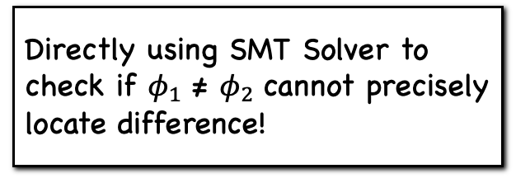
Challenges in Lifted Format Specification Differential Analysis
Directly using SMT Solver to check if ${\text{φ}}_{1}$ ≠ ${\text{φ}}_{2}$ cannot precisely locate difference!
$$φ_{X_{1}}=0<alen∧a\left[0\right]=0∧1≥alen$$
$$φ_{X_{2}}=0<alen∧a\left[0\right]≠0∧1<alen∧a\left[1\right]≤alen∧a\left[1\right]+2≥alen$$
${\text{φ}}_{1}$ = $φ_{X_{1}}$ | $φ_{X_{2}}$
Hard to locate bug in source code
Cannot find multiple bugs
$$φ_{Y_{1}}=0<alen∧a\left[0\right]=0∧1≥alen$$
$$φ_{Y_{2}}=0<alen∧a\left[0\right]≠0∧2≤alen∧a\left[1\right]+2≤alen∧a\left[1\right]+2≥alen$$
${\text{φ}}_{2}$ = $φ_{Y_{1}}$ | $φ_{Y_{2}}$
Notes:
To compare the two formats, we use the same symbol, a to represent packet buffer and alen to represent buffer length. Assume 𝜙1 and 𝜙2 are two format constraints obtained from their corresponding implementations. To find differences between two protocol implementations, it seems straightforward to use an SMT solver to check if 𝜙1 ≠ 𝜙2 is satisfiable. A satisfiable assignment indicates an input message that can be parsed in one implementation but not the other, thereby finding a semantic difference. However, this monolithic satisfiable assignment does not directly inform us which specific lines of the program contribute to the semantic discrepancy. Additionally, to expose all possible discrepancies, we must keep querying the SMT solver for various assignments. Hence, this coarse-grained use of the SMT solver is ineffective in locating the discrepancy between the two implementations

Slide 54











ParDiff Solution: Transforming Lifted Specs to Ordered SFAs
Transitions between states are induced by an ordering of constrained buffer indices.
$$φ_{X_{1}}=0<alen∧a\left[0\right]=0∧1≥alen$$
$$φ_{X_{2}}=0<alen∧a\left[0\right]≠0∧1<alen∧a\left[1\right]≤alen∧a\left[1\right]+2≥alen$$
$$0<alen∧1≥alen$$
$$a\left[0\right]=0$$
$${ 𝕊}_{2}$$
$${ 𝕊}_{4}$$
$$0<alen∧1<alen$$
$$a\left[0\right]≠0$$
$$a\left[1\right]≤alen∧a\left[1\right]+2≥alen$$
$${ 𝕊}_{0}$$
$${ 𝕊}_{1}$$
$${ 𝕊}_{3}$$
$${ 𝕊}_{5}$$
Notes:
To precisely locate the buggy statements in the protocol parser, ParDiff must not only identify the specific constraints that lead to semantic differences, but also compare the two format constraints in a fine-grained way. To achieve the goal, ParDiff transforms each format constraint to an FSM, which encodes the spatial parsing logic of the protocol format. Edges are conditioned by constraints imposed on the input messages. Transitions between states are ordered by constrained buffer indices. That is, if one state transition is constrained by the 𝑖-th element of a network message, its immediately subsequent state transitions should be constrained by the 𝑖 + 1-th element. This ensures that we can align two FSMs by the order of how they constrain the input memory buffer.

Slide 55











ParDiff Solution: Transforming Lifted Specs to Ordered SFAs
Transitions between states are induced by an ordering of constrained buffer indices.
$$φ_{X_{1}}=0<alen∧a\left[0\right]=0∧1≥alen$$
$$φ_{X_{2}}=0<alen∧a\left[0\right]≠0∧1<alen∧a\left[1\right]≤alen∧a\left[1\right]+2≥alen$$
$$0<alen∧1≥alen$$
$$a\left[0\right]=0$$
$${ 𝕊}_{2}$$
$${ 𝕊}_{4}$$
$$0<alen∧1<alen$$
$$a\left[0\right]≠0$$
$$a\left[1\right]≤alen∧a\left[1\right]+2≥alen$$
$${ 𝕊}_{0}$$
$${ 𝕊}_{1}$$
$${ 𝕊}_{3}$$
$${ 𝕊}_{5}$$
$$φ_{Y_{1}}=0<alen∧a\left[0\right]=0∧1≥alen$$
$$φ_{Y_{2}}=0<alen∧a\left[0\right]≠0∧2≤alen∧a\left[1\right]+2≤alen∧a\left[1\right]+2≥alen$$
$$0<alen∧1≥alen$$
$$a\left[0\right]=0$$
$${ 𝕊}_{2}$$
$${ 𝕊}_{4}$$
$$a\left[1\right]+2≤alen∧a\left[1\right]+2≥alen$$
$$0<alen∧2≤alen$$
$$a\left[0\right]≠0$$
$${ 𝕊}_{0}$$
$${ 𝕊}_{1}$$
$${ 𝕊}_{3}$$
$${ 𝕊}_{5}$$
Notes:
To precisely locate the buggy statements in the protocol parser, ParDiff must not only identify the specific constraints that lead to semantic differences, but also compare the two format constraints in a fine-grained way. To achieve the goal, ParDiff transforms each format constraint to an FSM, which encodes the spatial parsing logic of the protocol format. Edges are conditioned by constraints imposed on the input messages. Transitions between states are ordered by constrained buffer indices. That is, if one state transition is constrained by the 𝑖-th element of a network message, its immediately subsequent state transitions should be constrained by the 𝑖 + 1-th element. This ensures that we can align two FSMs by the order of how they constrain the input memory buffer.

Slide 56

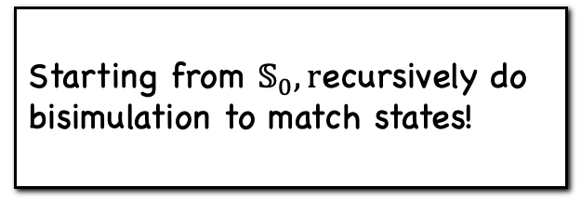






ParDiff Solution: Synced Bi-simulation
Starting from $𝕊_{0}, r$ecursively do bisimulation to match states!
$$φ_{X_{1}}=0<alen∧a\left[0\right]=0∧1≥alen$$
$$φ_{X_{2}}=0<alen∧a\left[0\right]≠0∧1<alen∧a\left[1\right]≤alen∧a\left[1\right]+2≥alen$$
$$0<alen∧1≥alen$$
$$a\left[0\right]=0$$
$${ 𝕊}_{2}$$
$${ 𝕊}_{4}$$
$$0<alen∧1<alen$$
$$a\left[0\right]≠0$$
$$a\left[1\right]≤alen∧a\left[1\right]+2≥alen$$
$${ 𝕊}_{0}$$
$${ 𝕊}_{1}$$
$${ 𝕊}_{3}$$
$${ 𝕊}_{5}$$
$$φ_{Y_{1}}=0<alen∧a\left[0\right]=0∧1≥alen$$
$$φ_{Y_{2}}=0<alen∧a\left[0\right]≠0∧2≤alen∧a\left[1\right]+2≤alen∧a\left[1\right]+2≥alen$$
$$0<alen∧1≥alen$$
$$a\left[0\right]=0$$
$${ 𝕊}_{2}$$
$${ 𝕊}_{4}$$
$$0<alen∧2≤alen$$
$$a\left[0\right]≠0$$
$$a\left[1\right]+2≤alen∧a\left[1\right]+2≥alen$$
$${ 𝕊}_{0}$$
$${ 𝕊}_{1}$$
$${ 𝕊}_{3}$$
$${ 𝕊}_{5}$$
Notes:
Given two FSMs produced in the previous stage, we use bisimulation to compare two FSMs, which can efficiently find nonequivalent state transitions. Starting from S0, we can establish a bisimulation between S0 → S1 and S0′→ S1, S0 → S2 and S0′→ S2, S2 → S4 and S2′→ S4, S1 → S3 and S1′ → S3’, since their transition conditions are equivalent; however, the transitions S3 → S5 and S3′ → S5′do not bisimulate each other. Hence we find a difference between the two implementations.
For bisimulation, we use SMT-solver to compare the the constraints on the edges.in this example, although $1<alen$ and 2$≤alen$ looks different, they are equivalent.

Slide 57
Summary
Observation 1: Path condition implies both syntax and semantics of protocol formats
Observation 2: Path condition can be easily transformed to a BNF-style protocol format
Challenge 1: Path Explosion
Solution 1: Localized Path Sensitivity
Challenge 2: Disordered Path Condition
Solution 2: Path Reordering Algorithm
Notes:
As a summary, our approach are built on top of two observations and address two challenges related to path condition,
It allows our static analysis to achieve high recall/ precision and efficiency.

Slide 58
Summary
Observation 1: Path condition implies both syntax and semantics of protocol formats
Observation 2: Path condition can be easily transformed to a BNF-style protocol format
Challenge 1: Path Explosion
Solution 1: Localized Path Sensitivity
Challenge 2: Disordered Path Condition
Solution 2: Path Reordering Algorithm
High Recall (Coverage)
High Precision
High Efficiency
Static Analysis for Protocol Format Reverse Engineering
Notes:
As a summary, our approach are built on top of two observations and address two challenges related to path condition,
It allows our static analysis to achieve high recall/ precision and efficiency.

Slide 59
Summary
Observation 1: Path condition implies both syntax and semantics of protocol formats
Observation 2: Path condition can be easily transformed to a BNF-style protocol format
Challenge 1: Path Explosion
Solution 1: Localized Path Sensitivity
Challenge 2: Disordered Path Condition
Solution 2: Path Reordering Algorithm
High Recall (Coverage)
High Precision
High Efficiency
Close to 100%
Close to 100%
< 1min
Static Analysis for Protocol Format Reverse Engineering
Parser differential can be achieved by ordered SFAs and synchronized bi-simulation
Notes:
As a summary, our approach are built on top of two observations and address two challenges related to path condition,
It allows our static analysis to achieve high recall/ precision and efficiency.

Slide 60
Future Work
Domain specific analysis allows us to go beyond traditional general purpose program analysis
  Enable us to check the much richer domain specific properties
    Smart contract bug finding (e.g., the team has >$300k bounty)
    Robotic vehicle modeling
Domain specific analysis requires domain specific models, and lifting is the way to go!
  E.g., LLM based lifting
Notes:
As a summary,….

Slide 61
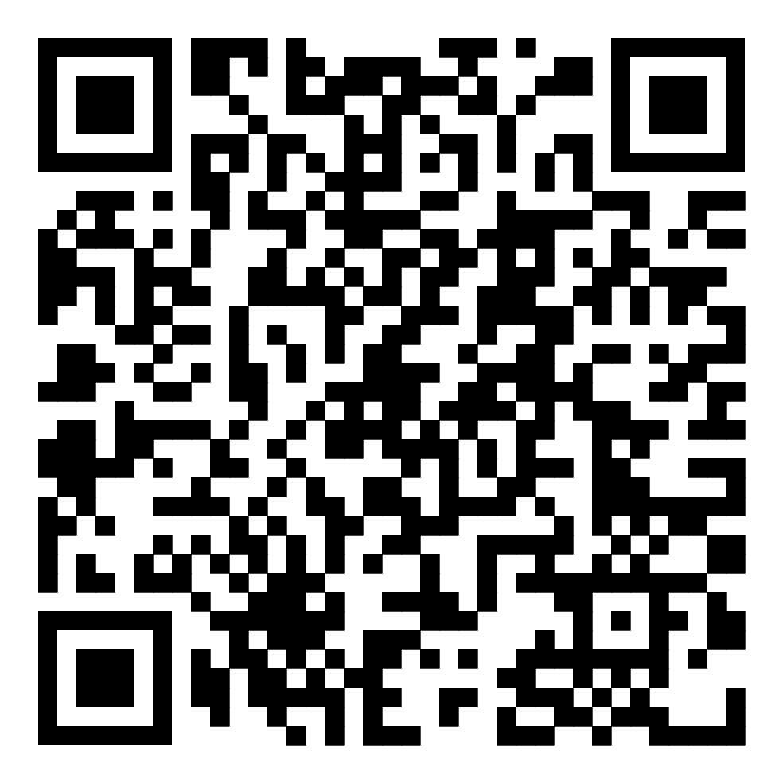
THANKS FOR YOUR TIME!
(CCS’23) Lifting Network Protocol Implementation to Precise Format Specification with Security Applications, Qingkai Shi, Junyang Shao, Yapeng Ye, Mingwei Zheng, Xiangyu Zhang. The ACM Conference on Computer and Communications Security (CCS '23)
(OOPSLA’24) ParDiff: Practical Static Differential Analysis of Network Protocol ParsersMingwei Zheng, Qingkai Shi, Xuwei Liu, Xiangzhe Xu, Le Yu, Congyu Liu, Guannan Wei, Xiangyu Zhang. Proceedings of the ACM on Programming Languages (OOPSLA '24)
Our system is publicly available on GitHub.
Issues and pull requests are welcome.

