Slide 1
Security Challenges of
Parsing Differentials on the Web
Bahruz Jabiyev

Slide 2

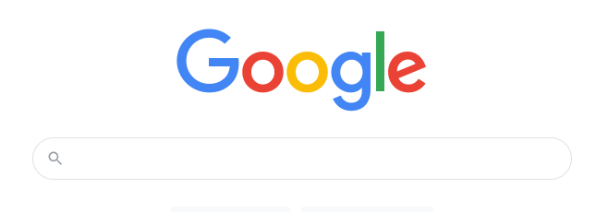
Web Content Delivery
www.google.com

Slide 3
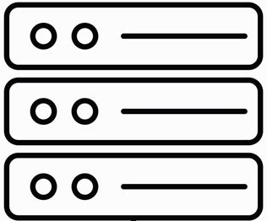
Back in the Day
Web Server

Slide 4
Behind the Scene
Akamai
Varnish
Haproxy
Apache
Reverse Proxy
Reverse Proxy
Reverse Proxy
Web Server
CDN server
Cache Server
Load Balancer
Origin Server

Slide 5
Security Challenges of Web Parsing Differentials
Fundamentally New Class of Attacks
ACM CCS 2021
(Under Submission Work)
Enhanced Fingerprinting Capability
NDSS 2024
New Approach to Bypassing
Web Application Firewalls
(Ongoing Work)

Slide 6
HTTP protocol
POST /search HTTP/1.1
Host: google.com
Content-Length: 16
query=funny+cats
POST /search HTTP/1.1
Host: google.com
Transfer-Encoding: chunked
6
query=
A
funny+cats
0
funny cats

Slide 7
HTTP Request Smuggling (HRS)
POST /search HTTP/1.1
Host: google.com
Content-Length: 16
query=funny+cats
POST /search HTTP/1.1
Host: google.com
Transfer-Encoding: chunked
6
query=
A
funny+cats
0
Notes:
Remove chunk extension and trailer stuff

Slide 8
HTTP Request Smuggling (HRS)
POST /search HTTP/1.1
Host: google.com
Transfer-Encoding: chunked
6
query=
A
funny+cats
0
Reverse Proxy
Origin

Slide 9
HTTP Request Smuggling (HRS)
POST /search HTTP/1.1
Host: google.com
Transfer-Encoding: chunked
Content-Length: 39
6
query=
A
funny+cats
0
AAAAAAAAAA
;
Reverse Proxy
Origin
Notes:
Note that reverse proxy uses the same connection for the next request

Slide 10
HTTP Request Smuggling (HRS)
POST /search HTTP/1.1
Host: google.com
Transfer-Encoding:;chunked
Content-Length: 39
6
query=
A
funny+cats
0
AAAAAAAAAA
Reverse Proxy
Origin
AAAAAAAAAA
Notes:
Note that reverse proxy uses the same connection for the next request

Slide 11
HTTP Request Smuggling (HRS)
GET /blog HTTP/1.1
Host: google.com
AAAAAAAAAA
AAAAAAAAAA
Notes:
Note that reverse proxy uses the same connection for the next request

Slide 12
HTTP Request Smuggling (HRS)
GET /smuggled HTTP/1.1
Host: google.com
GET /smuggled HTTP/1.1
X:X
GET /blog HTTP/1.1
Host: google.com
Notes:
Note that reverse proxy uses the same connection for the next request

Slide 13
Attacks
Response Queue Poisoning
  Google, Atlassian
Request Hijacking
  Trello, Slack
Web Cache Poisoning
  Paypal
Several other attacks
TLS does not help

Slide 14
T-Reqs
Methodology for searching discrepancies
Grammar-based HTTP fuzzer
Experiments
  Request Line
  Request Headers
  Request Body

Slide 15
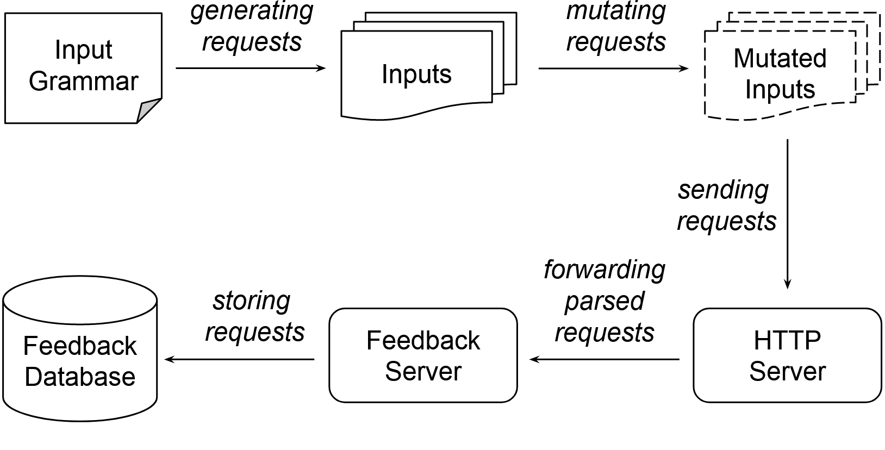
T-Reqs: Systematic Search for Discrepancies
Apache httpd
NGINX
Apache Tomcat
Apache httpd
GET /abc HTTP/1.1
Host: abc
NGINX
GET /abc HTTP/1.1
Host: abc
Content-Length: 4
BBBB
ATS
HAProxy
Squid
Varnish
Akamai
Cloudflare
CloudFront

Slide 16
Experiments
Request Line
Request Headers
Request Body

Slide 17
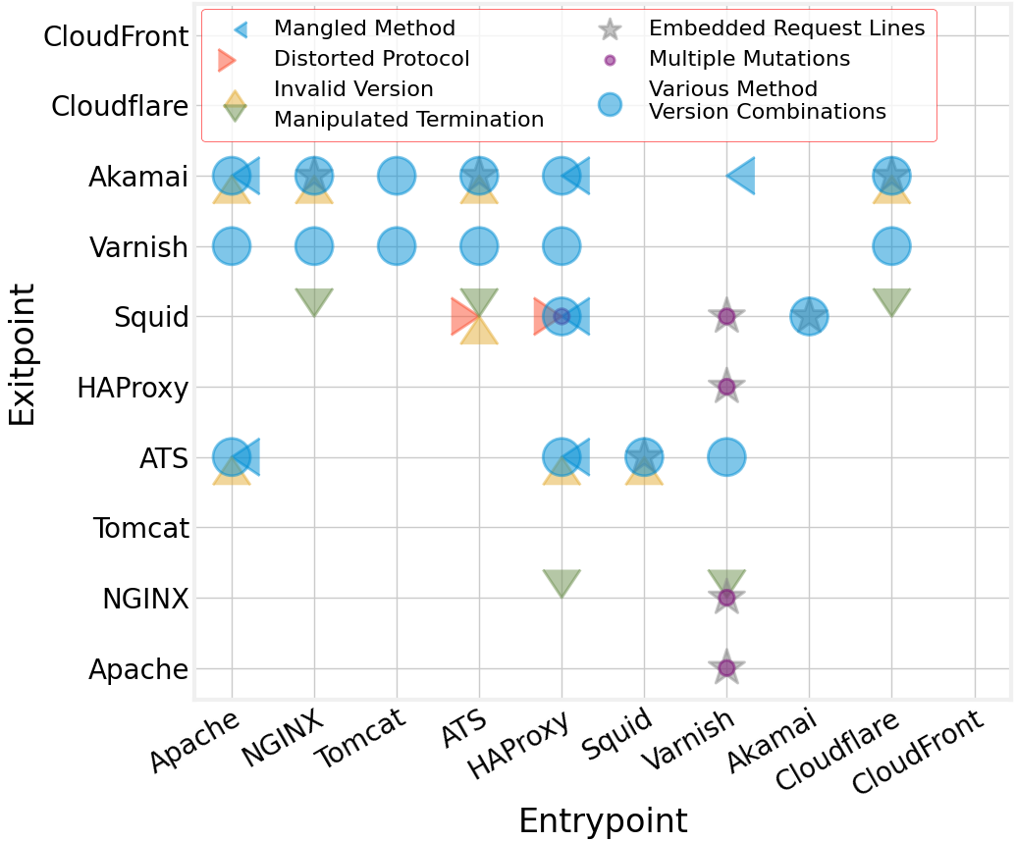
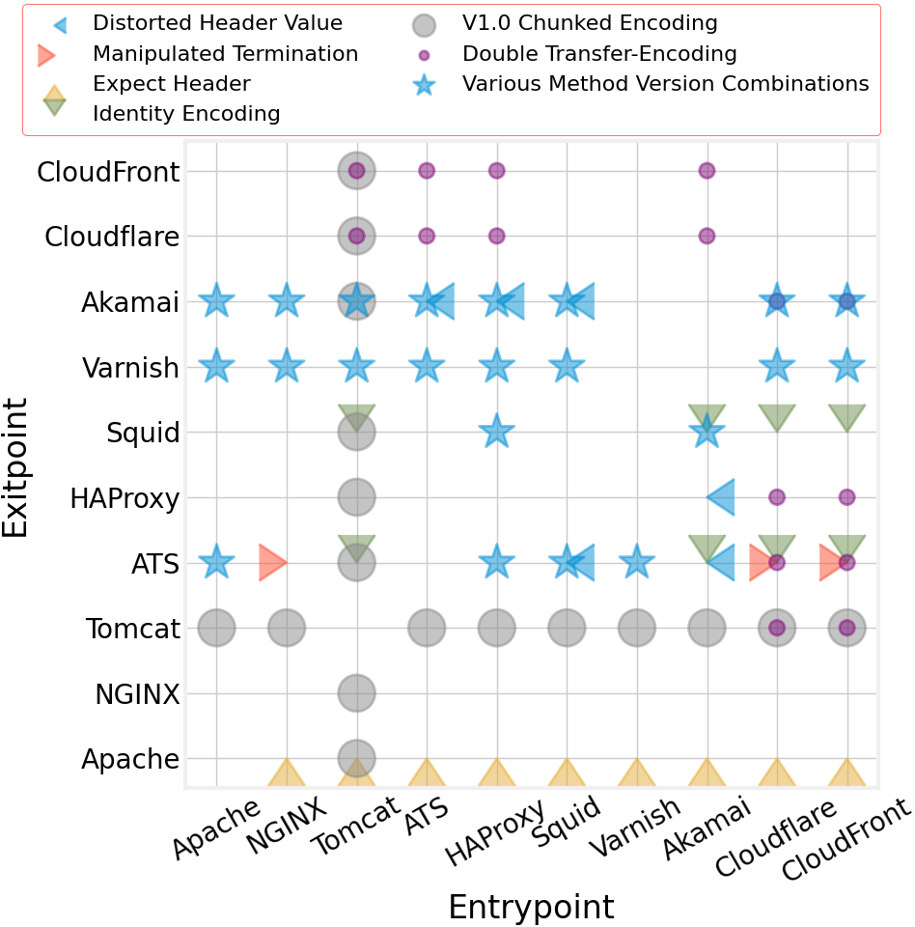
Category | Request Line
Distorted Protocol | GET / PTTP/1.1
Mangled Method | . / HTTP/0.9
Method Version Comb. | DELETE / HTTP/0.9
Multiple Mutations | GET / HTTP//1.1
Notes:
Bring category names and point together

Slide 18
Mutation Ctg. | Request Line
Distorted Protocol | GET / PTTP/1.1
Mangled Method | . / HTTP/0.9
Method Version Comb. | DELETE / HTTP/0.9
Multiple Mutations | GET / HTTP//1.1
Notes:
Bring category names and point together

Slide 19
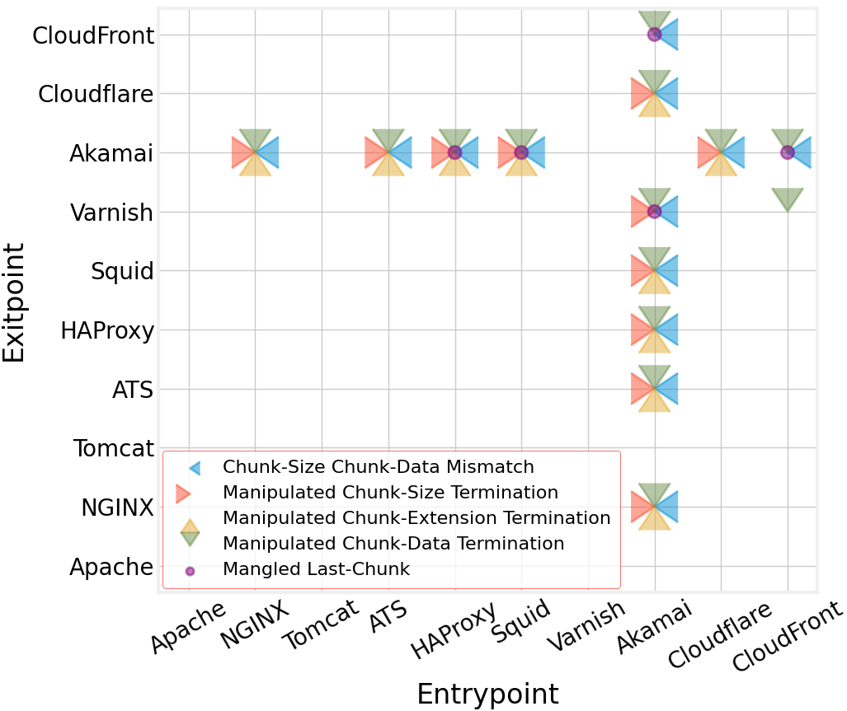
Request Headers
Request Line
Request Body

Slide 20
Request Headers
Request Line
Request Body

Slide 21
Vendors' Actions
Vendors confirmed the attacks and assigned CVEs
Some of them took months to fix, some were not fixed at all
Notes:
Move ats to the end

Slide 22
Disclosure
Apache Tomcat and Traffic Server assigned CVE numbers
NGINX implemented hardening measures
CloudFront discovered holes in their defense
Akamai coordinated a response with the co-author
Apache Traffic Server developers added T-Reqs to their toolset
Notes:
Move ats to the end

Slide 23
Body parsing discrepancies are quite common, and they may lead to fundamentally new cyber attacks.

Slide 24
Guided Differential Fuzzing for Discrepancies
Approach for Guided Differential Fuzzing
  Guide the input selection for more code-coverage
Holistic Search Method
  Search for discrepancies in every part of an HTTP request, not just the body
Server Name | Version | Source
Apache httpd | 2.4.54 | C
NGINX | 1.22.1 | C
H2O | 2.2.6 | C
Apache Traffic Server (ATS) | 10.0.0 | C++
HAProxy | 2.7.1 | C
Envoy Proxy | 1.24.1 | C++
Notes:
Move ats to the end

Slide 25
URI Discrepancy Instances
Input | Apache httpd | NGINX | H2O | ATS | HAProxy | Envoy Proxy
GET http: H/1 | GET / H/1 | Bad Request Error | GET /http: H/1 | Connection Reset | Bad Request Error | Bad Request Error
GET /%2f H/1 | Not Found Error | GET / H/1 | GET /%2f H/1 | GET /%2f H/1 | GET /%2f H/1 | GET /%2f H/1
Notes:
Move ats to the end

Slide 26
Additional Attacks

Slide 27
Cache Poisoning
(encoded /home)
GET %2fhome HTTP/1.1
Host: victim.com
(cache expired: /home)
GET %2fhome HTTP/1.1
Host: victim.com
404 Not Found
(caching 404 for /home)

Slide 28
Cache Poisoning
GET /home HTTP/1.1
Host: victim.com
404 Not Found

Slide 29
Access Control Bypass
GET /admin HTTP/1.1
Host: victim.com
403 Forbidden

Slide 30
Access Control Bypass
GET http:/admin HTTP/1.1
Host: victim.com
GET http:/admin HTTP/1.1
Host: victim.com
/admin page

Slide 31
URI parsing discrepancies between servers can also have serious security implications.

Slide 33
Security Challenges of Distributed Content Delivery
Fundamentally New Class of Attacks
ACM CCS 2021
USENIX Security 2022
(Under Submission Work)
Enhanced Fingerprinting Capability
NDSS 2024
New Approach to Bypassing
Web Application Firewalls
(Ongoing Work)

Slide 34
Security Challenges of Web Parsing Differentials
Fundamentally New Class of Attacks
ACM CCS 2021
(Under Submission Work)
Enhanced Fingerprinting Capability
NDSS 2024
New Approach to Bypassing
Web Application Firewalls
(Ongoing Work)

Slide 35
Server Fingerprinting
Each exploit usually affect a specific server with certain versions.
Reverse Proxy
Reverse Proxy
Reverse Proxy
Web Server

Slide 36
Server Fingerprinting
Attackers need to know the server name and version before exploiting.
Web Server
Error Response

Slide 37
Distinct Server Errors
HTTP/1.1 400 Bad Request
…
<html><head>
<title>400 Bad Request</title>
</head><body>
<h1>Bad Request</h1>
<p>Your browser sent a request that this server could not understand.<br />
</p>
</body></html>
HTTP/1.1 400 Bad Request
…
<html>
<head><title>400 Bad Request</title></head>
<body>
<center><h1>400 Bad Request</h1></center>
<hr><center>nginx/1.25.4</center>
</body>
</html>
Apache
NGINX
HTTP/1.1 400 Bad Request
…
<!doctype html><html lang="en"><head>
<title>HTTP Status 400 – Bad Request</title>
<style type="text/css">
…
HTTP/1.1 400 Bad Request
Content-Type: text/plain; charset=utf-8
Connection: close
400 Bad Request
Tomcat
Caddy

Slide 38
False Sense of Security
OWASP recommends:
  reverse proxy “to create an additional layer of security” against fingerprinting
Reverse Proxy
Reverse Proxy
Web Server
In fact, Nmap and others usually tell only the first layer.

Slide 39
Multilayer Fingerprinting
We trigger an error response in each server layer.
We take advantage of parsing discrepancies between servers.
Reverse Proxy
Reverse Proxy
Web Server
We develop a new tool, Untangle, for multilayer fingerprinting.

Slide 40
Untangle
?
?
?
POST /a\rbc HTTP/1.1
Host: example.com
Content-Length: 13
query=bananas
Akamai CDN
HAProxy
Apache
POST /a\x7fbc HTTP/1.1
Host: example.com
Content-Length: 13
query=bananas
POST\r /abc HTTP/1.1
Host: example.com
Content-Length: 13
query=bananas
We use T-Reqs to create a request database for 13 popular servers.
We take an experiment on 756 distinct three-layer server combinations.
100% in the first, 90.3% in the second, 50.7% in the third layer.

Slide 41
Parsing discrepancies between servers enhance the fingerprinting capabilities of attackers.

Slide 43
Security Challenges of Distributed Content Delivery
Fundamentally New Class of Attacks
ACM CCS 2021
USENIX Security 2022
(Under Submission Work)
Enhanced Fingerprinting Capability
NDSS 2024
New Approach to Bypassing
Web Application Firewalls
(Ongoing Work)

Slide 44
Security Challenges of Web Parsing Differentials
Fundamentally New Class of Attacks
ACM CCS 2021
(Under Submission Work)
Enhanced Fingerprinting Capability
NDSS 2024
New Approach to Bypassing
Web Application Firewalls
(Ongoing Work)

Slide 45
Security Filtering
POST / HTTP/1.1
Host: victim.com
param=<attack-payload>
Web Server

Slide 46
Security Filtering on a Proxy
Easily adaptable policy
Better protection against new and emerging attacks
Higher traffic capacity
WAF
Web Server
Notes:
Big Internet Companies such as Akamai, Cloudflare, AWS maintains attack rules. It is good for both existing and new attack vectors.
No need to change the application.
Better protection against DoS attacks

Slide 47

Traditional Bypass
Disguising the attack payload
Barely effective as WAFs are well aware of these methods
WAF
Web Server
POST / HTTP/1.1
Host: victim.com
param=<attack-payload>
POST / HTTP/1.1
Host: victim.com
param=YXR0YWNr

Slide 48
New Bypass Method
No need to modify the attack payload
Parsing discrepancies in complex content types (e.g., application/xml)
Mutating the request body (excluding the attack payload), in a way that
  WAF fails to parse the request body (due to mutations) and forwards
  Web application framework parses (despite the mutations) and executes
Notes:
Big Internet Companies such as Akamai, Cloudflare, AWS maintains attack rules. It is good for both existing and new attack vectors.
No need to change the application.
Better protection against DoS attacks

Slide 49
New Bypass Method
Testing popular WAFs and web application frameworks
  AWS, Azure, Cloudflare, Google Cloud etc.
  Java Spring Boot, PHP Laravel, Node Express, Python Django etc.
We are testing three content types:
  multipart/form-data
  application/json
  application/xml

Slide 50
Multipart/form-data Example
POST / HTTP/1.1
Host: victim.com
Content-Type: application/x-www-form-urlencoded
query=<attack-payload>

Slide 51
Multipart/form-data Example
Cloudflare WAF
Express
POST / HTTP/1.1
Host: victim.com
Content-Type: multipart/form-data;boundary ="ABC"
--ABC
Content-Disposition: form-data; name=“query"
<attack-payload>
--ABC--

Slide 52
Content Type Study
Content-type study on form submission of 100 websites
application/x-www-form-urlencoded > 70%
Convertible to multipart/form-data > 90%
POST / HTTP/1.1
Host: victim.com
Content-Type: application/x-www-form-urlencoded
query=<attack-payload>
POST / HTTP/1.1
Host: victim.com
Content-Type: multipart/form-data;boundary=ABC
--ABC
Content-Disposition: form-data; name=“query"
<attack-payload>
--ABC--

Slide 53
Parsing discrepancies between WAFs and web application frameworks create a new method for bypassing WAFs.

Slide 55
Possible Future Directions
Parsing discrepancies in other web domains
  Other network protocols (e.g., DNS, SMTP)
  Networked web systems (e.g., service mesh)
Discrepancies more broadly
  Behavior discrepancies (e.g., connection, erroring)
Alternative search techniques for new attack vectors
  Formal methods

Slide 57


Thank you!
bahruz.jabiyev@dartmouth.edu
https://bahruz.me/

