Slide 1

Parsing, Performance, and Pareto in Data Stream Security
J. Peter Brady, Sean W. Smith
Dartmouth College
Image: DALL-E generated

Slide 2

Area of Interest
Using LangSec principles without unduly destroying performance
Search for ways to optimize the way we do parsing
  Selection or design of parsers
  Improve parsing performance
Image: DALL-E generated

Slide 3
Less Parsing, More Performance
Select input variables where LangSec can catch the most significant vulnerabilities
  Most used
  Highest number of errors
Better error checking than baseline
“The best is the enemy of the good” -- Voltaire

Slide 4
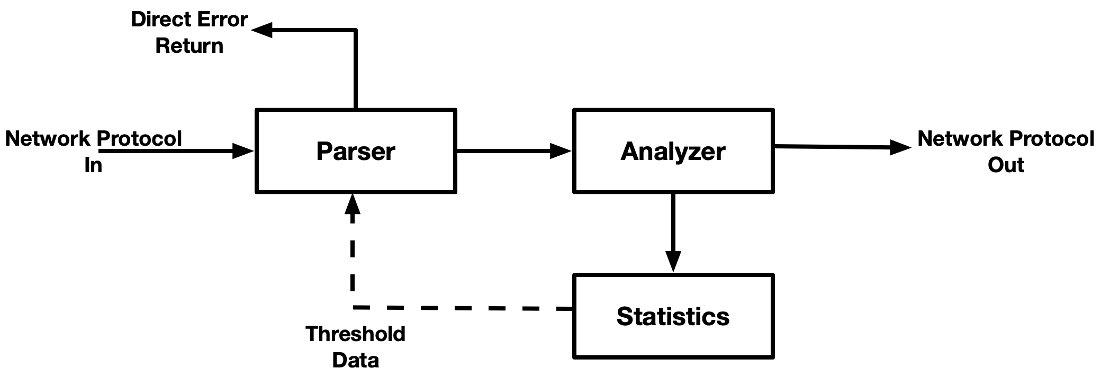
Global Unified Approach for Reliable Data Stream Security - guards
Sending network packet from client to server

Slide 5
Global Unified Approach for Reliable Data Stream Security - guards
Components
  Network File System (NFS) as network protocol
  Data Format Description Language (DFDL) as parser
  Game Theory and Pareto Analysis as analyzer
Bidirectional interception
  Parse commands from client to NFS server
  Parse replies from NFS server to client

Slide 6
Network Daemon - guardsd
Analyze the frequency and likelihood of error for commands
Over time, we only test the commands above the error threshold
The error threshold changes as we collect more data
NFS commands that fail parsing are returned directly to client
  The NFS server never sees potential error/malicious packet
NFS replies that have failures are collected against the command

Slide 7
DFDL
Uses Apache Daffodil
  Modeling language for describing data using XML Schema
Versatile for describing data structures

Slide 8
DFDL Sample
<xs:element name="onc_rpc">
<xs:complexType>
<xs:sequence>
<xs:element name="recfragment" type="oncrpc:fragmentType" />
<!– Start struct rpc_msg -->
<xs:element name="xid" type="xdr:unsignedInt" />
<xs:element name="mtype" type="xdr:unsignedInt" />
<xs:element name="rpc_dispatch">
<xs:complexType>
<xs:choice dfdl:choiceDispatchKey="{ xs:string(../mtype) }">
<xs:element name="call"
type="oncrpc:call_body" dfdl:choiceBranchKey="0" />
<xs:element name="reply"
type="oncrpc:reply_body" dfdl:choiceBranchKey="1" />
</xs:choice>
</xs:complexType>
</xs:element>
</xs:sequence>
</xs:complexType>
</xs:element>
struct rpc_msg {
unsigned int xid;
union switch (msg_type mtype) {
case CALL: call_body cbody;
case REPLY: reply_body rbody;
} body;
}
Beginning of an RPC message from RFC 5531
Notes:
Directly porting from the RFC to DFDL

Slide 9
DFDL Parser
Two parsers: one for NFSv3 and one for NFSv4.{0,1}
  Tests ONC-RPC headers then attached command
Parser tested separately using sbt
Parse data until
  Completely read
  Found an error
  Ran out of data
Daffodil to C converter
  Embed parser into guardsd

Slide 10
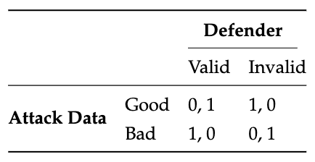
Game Theory in guards
Use a simple game where an attacker sends correct or flawed input data
The defender parses it and decides whether it is valid or invalid
The winner's payoff will be one, while the loser will receive nothing.
The defender wins the payoff if parses correctly
Otherwise, the attacker wins the payoff

Slide 11
Foreknowledge
We have no way of discerning whether an attacker is sending us good or bad data
  No way to assign a payoff
We can approximate the payoff by using foreknowledge
  Create a set of known-good data
  Create a set of known-bad data
  Calculate the outcomes for each command

Slide 12
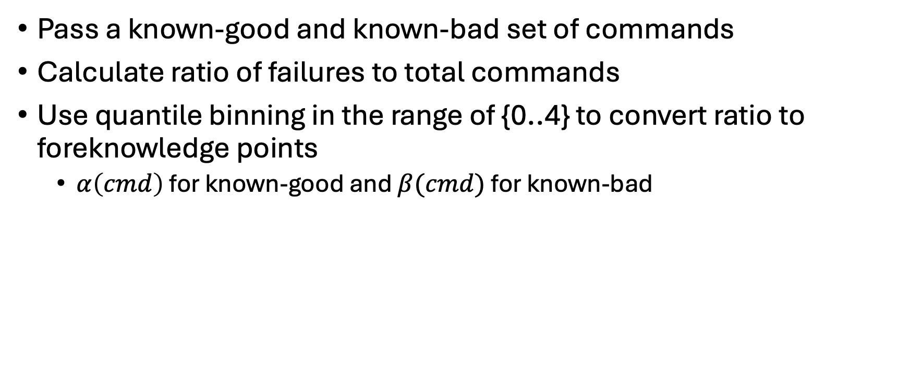
Calculating Foreknowledge
Pass a known-good and known-bad set of commands
Calculate ratio of failures to total commands
Use quantile binning in the range of {0..4} to convert ratio to foreknowledge points
  $α\left(cmd\right)$ for known-good and $β(cmd)$ for known-bad

Slide 13

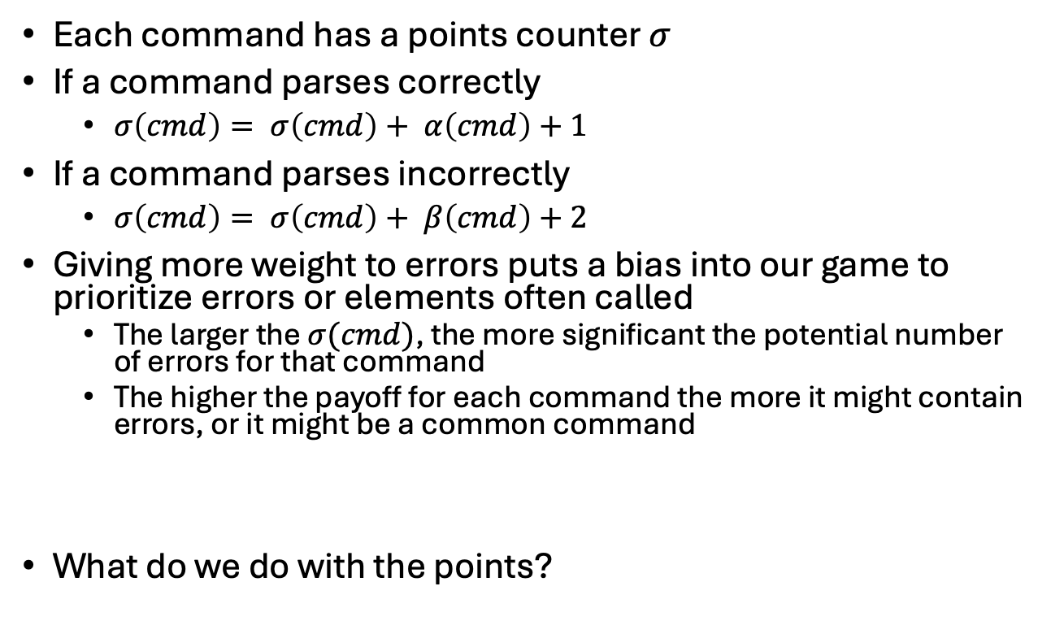
Calculating Points
Each command has a points counter $σ$
If a command parses correctly
  $σ\left(cmd\right)= σ\left(cmd\right)+ α\left(cmd\right)+1$
If a command parses incorrectly
  $σ\left(cmd\right)= σ\left(cmd\right)+ β\left(cmd\right)+2$
Giving more weight to errors puts a bias into our game to prioritize errors or elements often called
  The larger the $σ(cmd)$, the more significant the potential number of errors for that command
  The higher the payoff for each command the more it might contain errors, or it might be a common command
What do we do with the points?
Image: DALL-E generated

Slide 14
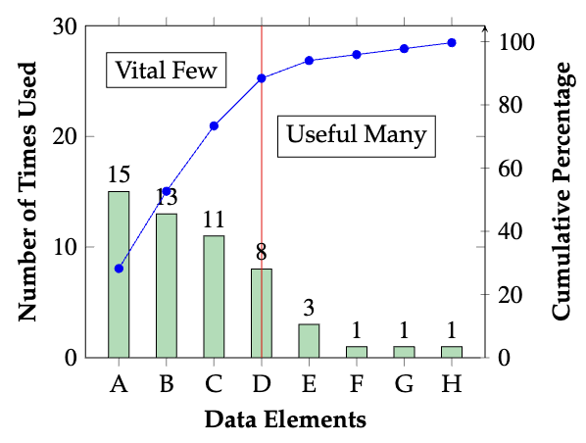
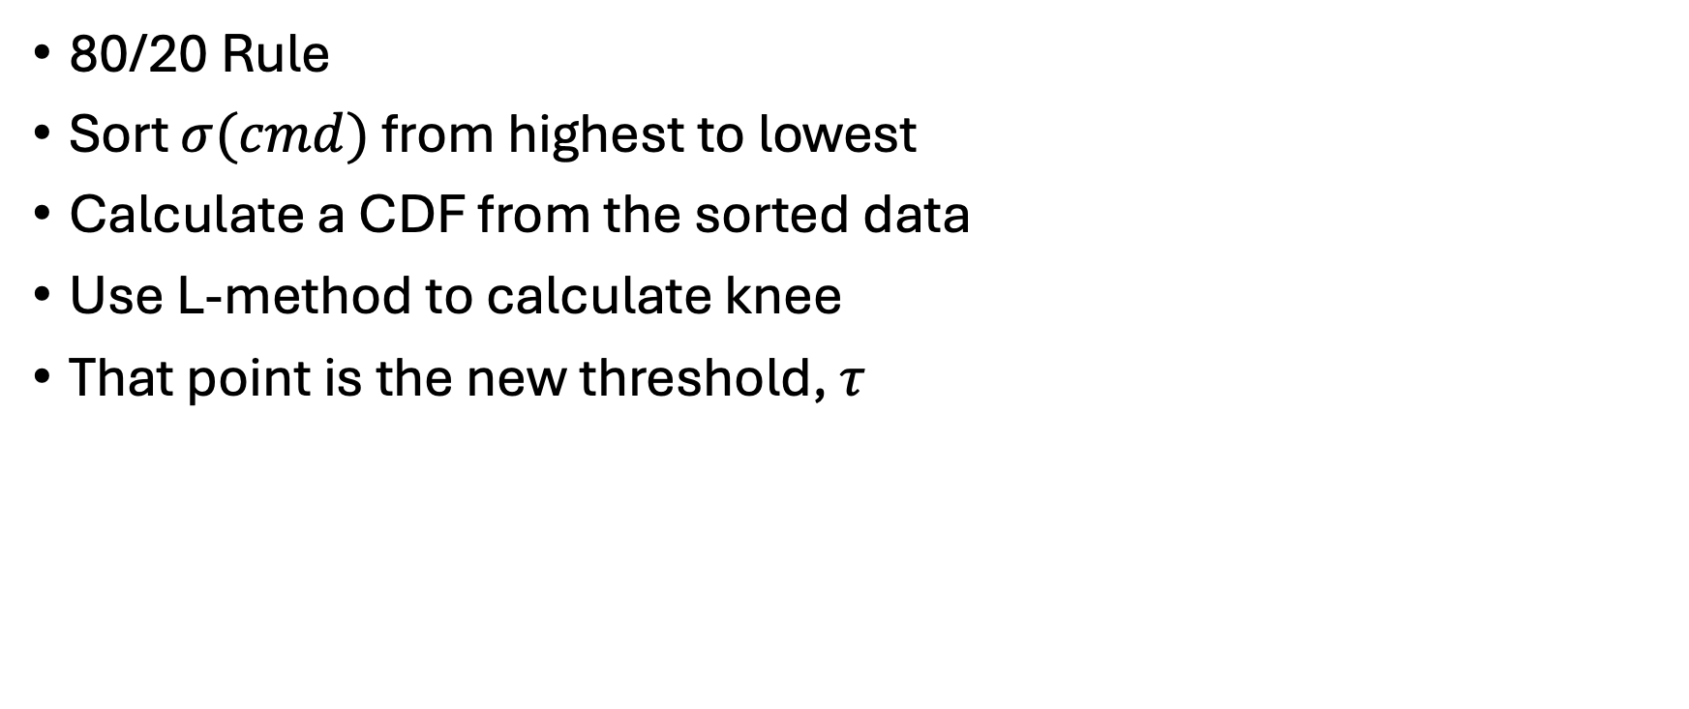
Pareto Principle
80/20 Rule
Sort $σ(cmd)$ from highest to lowest
Calculate a CDF from the sorted data
Use L-method to calculate knee
That point is the new threshold, $τ$
Notes:
Vilfredo Pareto, Italian economist. ~1900 Pareto observed that 20\% of the population owned approximately 80\% of the land in Italy. Joseph Juran, Western Electric QA 1930s noticed a similar ratio with failures

Slide 15
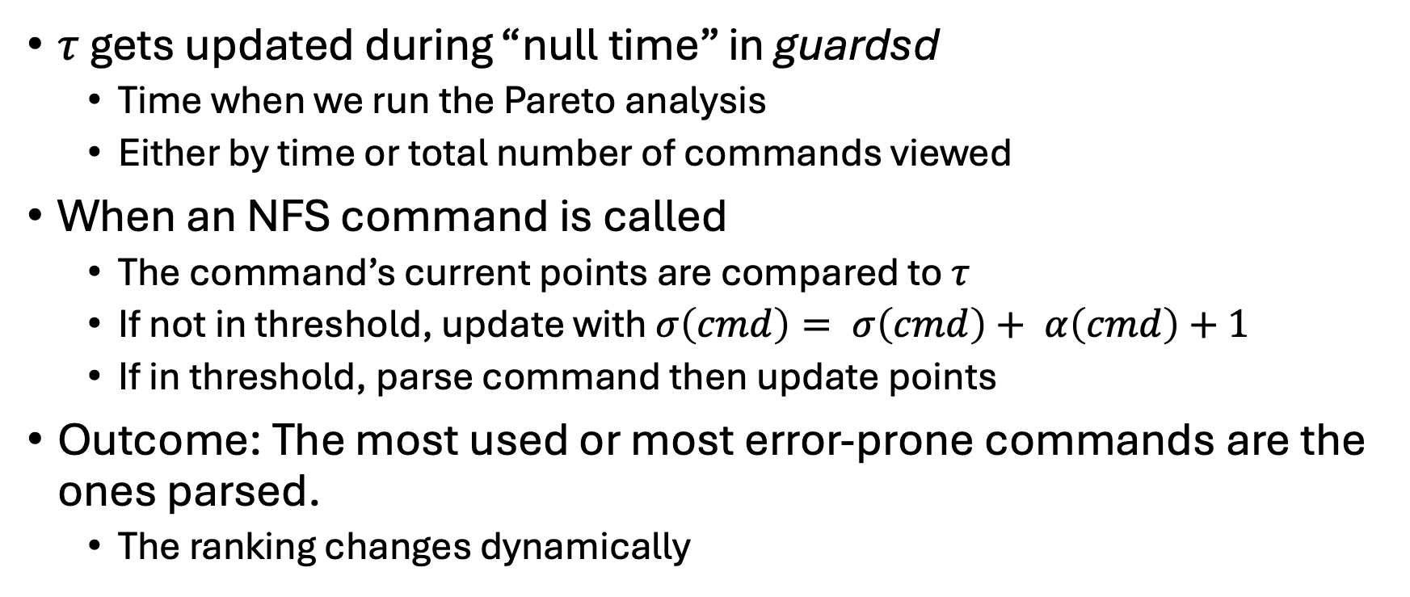
Parsing, Recalculated
$τ$ gets updated during “null time” in guardsd
  Time when we run the Pareto analysis
  Either by time or total number of commands viewed
When an NFS command is called
  The command’s current points are compared to $τ$
  If not in threshold, update with $σ\left(cmd\right)= σ\left(cmd\right)+ α\left(cmd\right)+1$
  If in threshold, parse command then update points
Outcome: The most used or most error-prone commands are the ones parsed.
  The ranking changes dynamically

Slide 16
Results
Initial tests used three scenarios
  List a remote directory
  Read a file from a remote directory
  Remove and write a file to a remote directory
Timed the round-trip interaction using Wireshark
  Run 10 times then averaged
  Restarted server after each run to clear any caching
Did not run foreknowledge beforehand
Notes:
NFSv3 - 21 cmds, 4.0 – 37 cmds, 4.1 – 52 cmds

Slide 17
Results
NFSv4.0
  Percentages are the amount slower than the baseline
Test | No Parsing | 100% Parsing | 50% Parsing | Min Parsing
Directory List | 4.42ms | 6.3ms (42.5%) | 4.68ms (5.9%) | 4.58ms (3.6%)
File Read | 4.34ms | 5.48ms (26.3%) | 4.34ms (0%) | 4.35ms (0.5%)
File Write | 5.6ms | 8.98ms (60.4%) | 6.42ms (14.6%) | 5.88ms (5.0%)
Mean of Tests | 4.79ms | 6.92ms (44.6%) | 5.15ms (7.5%) | 4.94ms (3.1%)
Notes:
NFSv3 - 21 cmds, 4.0 – 37 cmds, 4.1 – 52 cmds

Slide 18
Conclusions
DFDL can build a viable parser
  There is a learning curve, however
  Not every function is available when converting to C
guards introduces a way to prioritize errors
  Protect while keeping reasonable performance
  Address issues by optimizing commands with highest probability of failures

Slide 19
Future Work
Fuzzing to test the threshold adjustment
  Sim of a hacker trying to find failure points
  Addition to foreknowledge points
Adjustment of points
  Pass - fail ratio
  Adding vulnerability assessment to foreknowledge
Stats calc in a separate thread
  Classification of failing data
    Simhash

Slide 20
Thank You
Sean and my colleagues at Dartmouth
The GAPS team for their support, and especially John Interrante for providing best practices for creating DFDL code
This material is based upon work supported by the Defense Advanced Research Projects Agency (DARPA) under Contract No. HR001119C0121.
Any opinions, findings and conclusions or recommendations expressed in this material are those of the author(s) and do not necessarily reflect the views of the Defense Advanced Research Projects Agency (DARPA).

Slide 21
Questions
Email: jpb@cs.dartmouth.edu
Github: https://github.com/jpbdart/guards

