Slide 1
Weird Machines in Package Managers!
Sameed Ali, Dartmouth College
Michael Locasto, NARF Industries
Sean Smith, Dartmouth College

Slide 2

Introduction
Building trustworthy systems requires researchers to know what is computable by them and what is not.
Latent functionality in systems, however, allows for potential unauthorized computations by attackers.
It, therefore, poses a serious challenge for building secure, and trustworthy systems.
Notes:
Unexpected or Latent Functionality is a threat for secure systems.
Security researchers need to know kinds of computations can an adversary make in system.
Serious challenge for security.

Slide 3
Quick Background to Exploitation Research
Exploits as
Code Injection
Buffer overflow
Exploits as
Computation via feature reuse
ROP gadgets
Notes:
Exploitation research uses undiscovered features to build exploits.
Historically: inject code -> feature reuse.

Slide 4

What are Weird Machines?
Weird machines conceptualize the latent computational functionality in systems.
Weird machines are the abstract machines on which the unexpected computations run on.
Notes:
- When an attacker builds an exploit, they have in mind an abstract machine on which their exploit runs on.
- Weird machines are that underlying computational automaton that makes exploits possible.

Slide 5

How Are Weird Machines Constructed?
Attackers see crafted inputs as “programs” which run on the victim's machine.
Crafted input attacks repurpose a victim's own code to carry out unauthorized computations.
In doing so, attackers define an alternative semantics for the computational objects within a victim’s system.
Using the input to drive the weird machine present inside the system.
Notes:
- When an attacker builds an exploit, they have in mind an abstract machine on which their exploit runs on.
- Weird machines conceptualize that underlying computational automaton that makes exploits possible.
- Uncovering these semantics in a system is exploit development. It is discovering the weird machine.

Slide 6

Denotational Semantics
Mathematical signs represent Mathematical objects.
“3” is a numeral which represents the number three in our mind.
A hacker repurpose symbols inside computers by defining an alternative denotational semantics.

Slide 7

Denotational Semantics
“In a certain sense it is not possible to appeal to the meaning of the signs in mathematics, just because it is only mathematics that gives them their meaning.”
– Ludwig Wittgenstein, Remarks on the Foundations of Mathematics, Part V, 16.

Slide 8
What is their Significance?
Weird Machines are proofs for the presence of latent functionality.
They show the limits of what is computationally possible in a system.

Slide 9
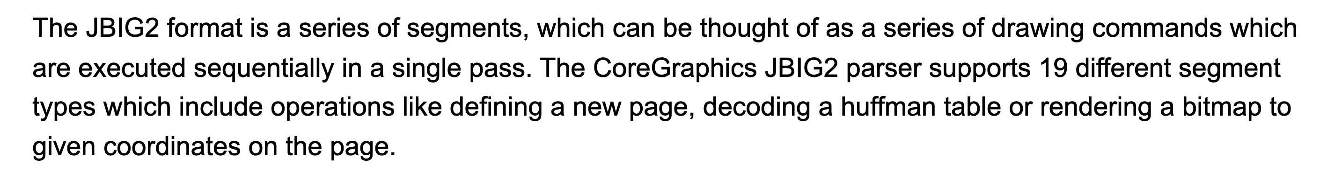
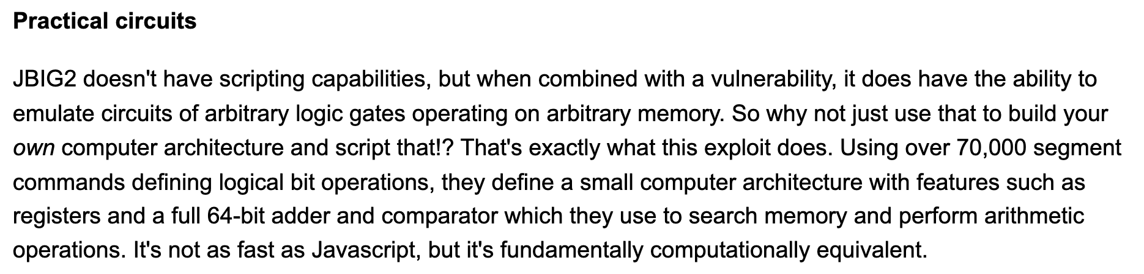
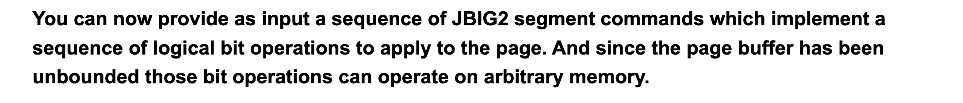
Real world
Example:
NSO zero-click iMessage
Targeted the PDF Parser. Repurposed JBIG2 compression to achieve TC.
Images source: Project Zero Blog [3]

Slide 10
Weird Machines Are Everywhere!
Some examples of prior work on weird machines
Weird Machine | Program
Linux Loader (Shapiro et al.) | ELF metadata
Page Table Fault Handler (Bangert et al.) | PT metadata
CPU Microarchitecture (Evtyushkin et al.) | Weird Circuits
Web Browser’s CSS Processor (Heiderich et al.) | CSS metadata

Slide 11

Research Questions
Is there a complexity floor of software features in a system beyond which weird machines becomes possible? Can we discover it at design time?
Take RPM, as an example of a complex system design and observe where WM can emerge.
Is the package manager’s metadata powerful enough to embed arbitrary computation within it?

Slide 12
Background:
Package Managers
Notes:
TIME: 5 MINUTES

Slide 13
Why Package Managers?
Feature rich and expressive enough for a variety of tasks.
Implicitly trusted by all software in a system.
Notes:
TIME: 5 MINUTES

Slide 14





WHAT CAN PACKAGE MANAGERS DO?
Dependency and conflict management
Compile code and install binaries
Rewrite file system
Verification of installed packages
Writes ephemeral files (logs etc.) on the filesystem.

Slide 15


NOT USING KNOWN ATTACK VECTORS
We know repo with malicious RPM binaries are a threat.
We know vulnerabilities in package managers are a risk.

Slide 16
Weird Machines Are Not Obfuscated Programs
Not writing an obfuscated program.
We are redefining the semantics of existing computational objects.
Repurposing latent functionality already present in a system.

Slide 17
IS PACKAGING LOGIC POWERFUL ENOUGH FOR ARBITRARY COMPUTATION?

Slide 18


OBJECTIVES
Compute with empty RPM packages!
WMs in package management infrastructure!

Slide 19
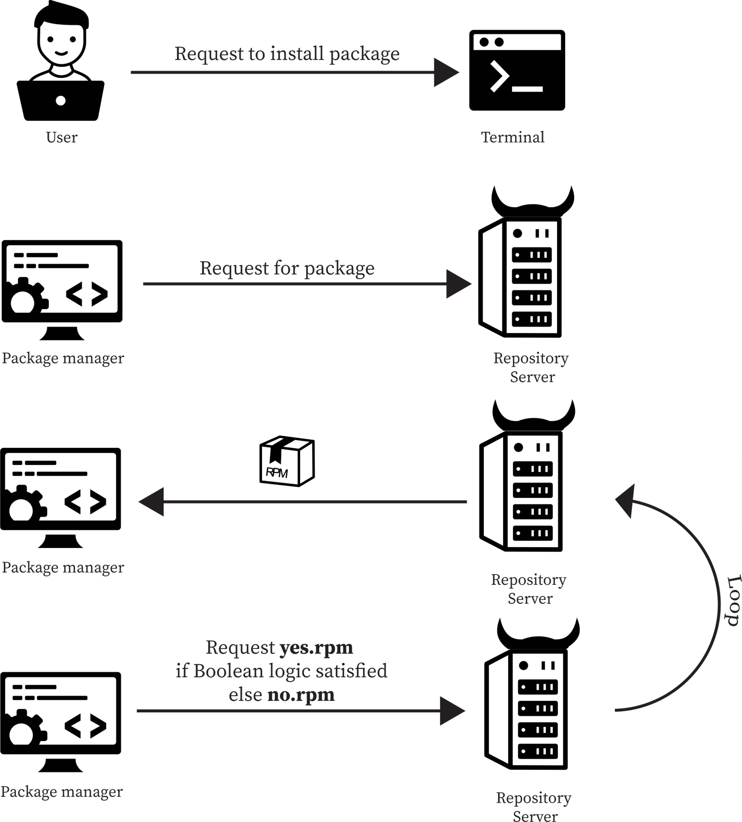
Computing with Package Metadata!
A compromised or evil repo which cannot carry RPM with malicious payloads (i.e., no exploit code in package)
Server can only manipulate RPM metadata. Cannot send corrupt/broken RPM packages.
At some regular update interval, the user updates their packages and installs upgrades.

Slide 20
Compute by installing a sequence of empty RPM packages

Slide 21
Compute by installing a sequence of empty RPM packages

Slide 22
RPM FEATURES USED IN WM CONSTRUCTION
Feature | Function | Used in WM?
Trigger/scriptlets | Run a script when another package is installed. | Yes
Strong dependency | Before installing a package ensure other packages are installed | Yes
Conflicts | Ensure package does not get installed if conflicting package present on system. | Yes
Macros | Scripting language which simplifies the build process. | No
Versioning | Multiple packages of same name but different versions. | No
Weak dependency | If dependency is available install it, otherwise don’t halt installation | Yes
Transactions | Ensure one package gets installed at at time | Yes
Conditional build | Build packages with –with configure flags | No
Relocatable Package | Change install location of package | No
Lua scripts | Lua scripts for additional expressivity when defining the package installation process. | No
Forward weak dependencies | Suggestions of packages to install alongside current package. | No

Slide 23
AVOID OBVIOUSLY POWERFUL FEATURES OF RPM PACKAGE MANAGER
Arbitrary Lua scripts in rpm spec files
Arbitrary Macro in rpm spec files
Exploit parsing issues in the RPM package file format
Overwriting file system to confuse the RPM runtime
Leverage Linux system services to construct the
Weird Machine

Slide 24
RPM Weird Machines!
Notes:
TIME: 10 Minutes!

Slide 25
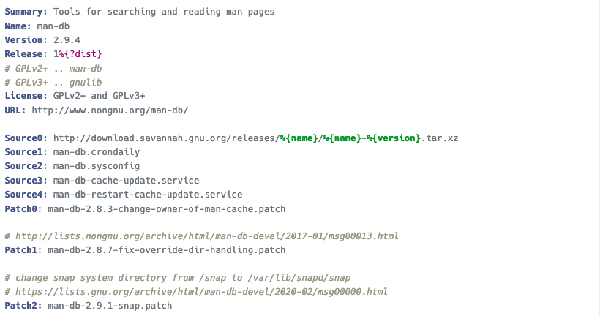
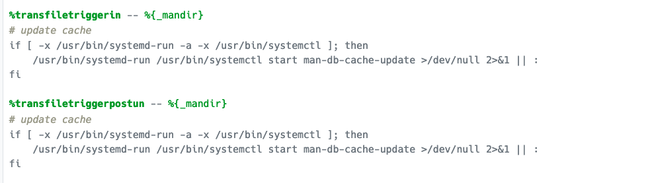
RPM
Spec File
Example
…

Slide 26
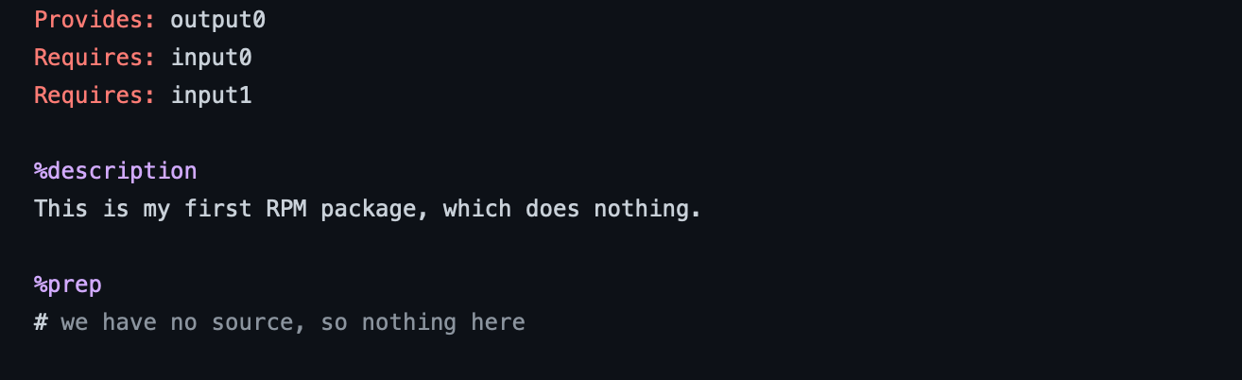
RPM Spec file: Dependency Requirements
aaa
Notes:
Install output0 if input0 AND input1 is installed on system!

Slide 27
RPM AND GATE!

Slide 28
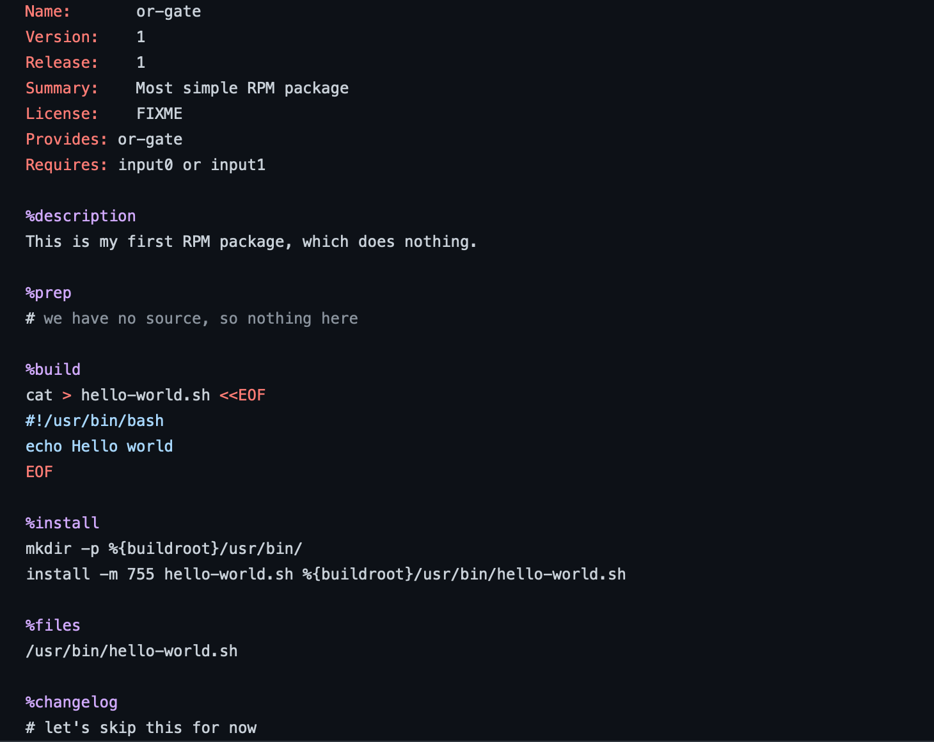
CONSTRUCTING AN RPM OR GATE
Notes:
“simple” example of a standard RPM install, e.g., emacs...(show how ‘rpm’ and dep mgr works)
sort of a manual trace (imagine a timeline/sequence of major rpm install runtime engine is ‘doing’) -vvvvvvv
register(Trigger t)
process(dep d)
eval( operation B)

Slide 29
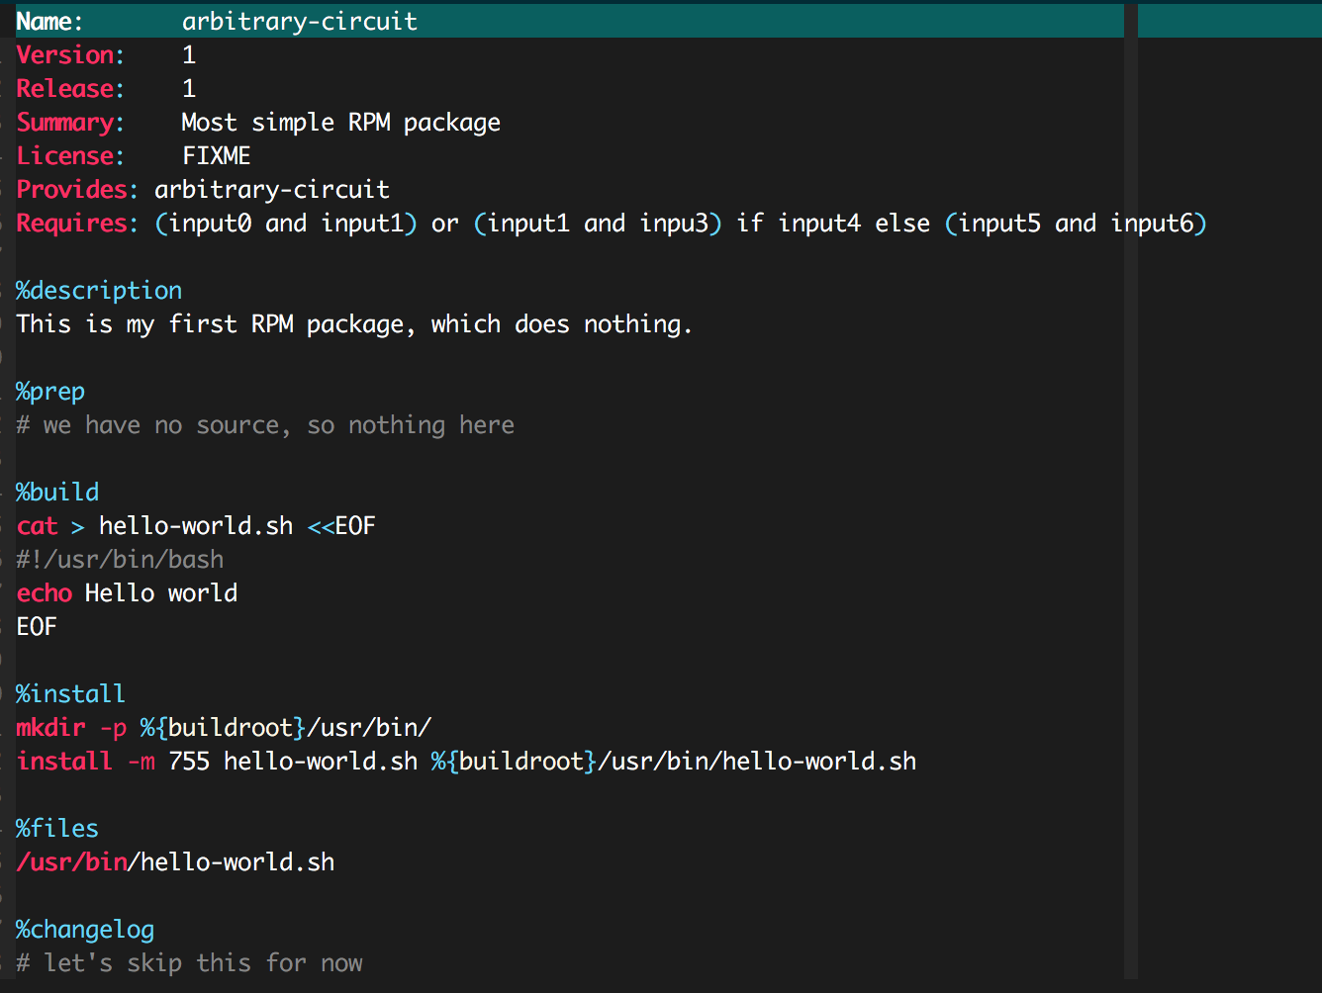
CONSTRUCTING ARBITRARY BOOLEAN CIRCUIT

Slide 30

Can a powerful computing machine be built with this metadata?

Slide 31
Rule 110 Automata
An Array of cells (tape).
At each time step value updated values for each cell is calculated.
Updated value of each cell in tape depends on its neighbors, its previous value.
Current pattern | 111 | 110 | 101 | 100 | 011 | 010 | 001 | 000
New Cell Value | 0 | 1 | 1 | 0 | 1 | 1 | 1 | 0

Slide 32
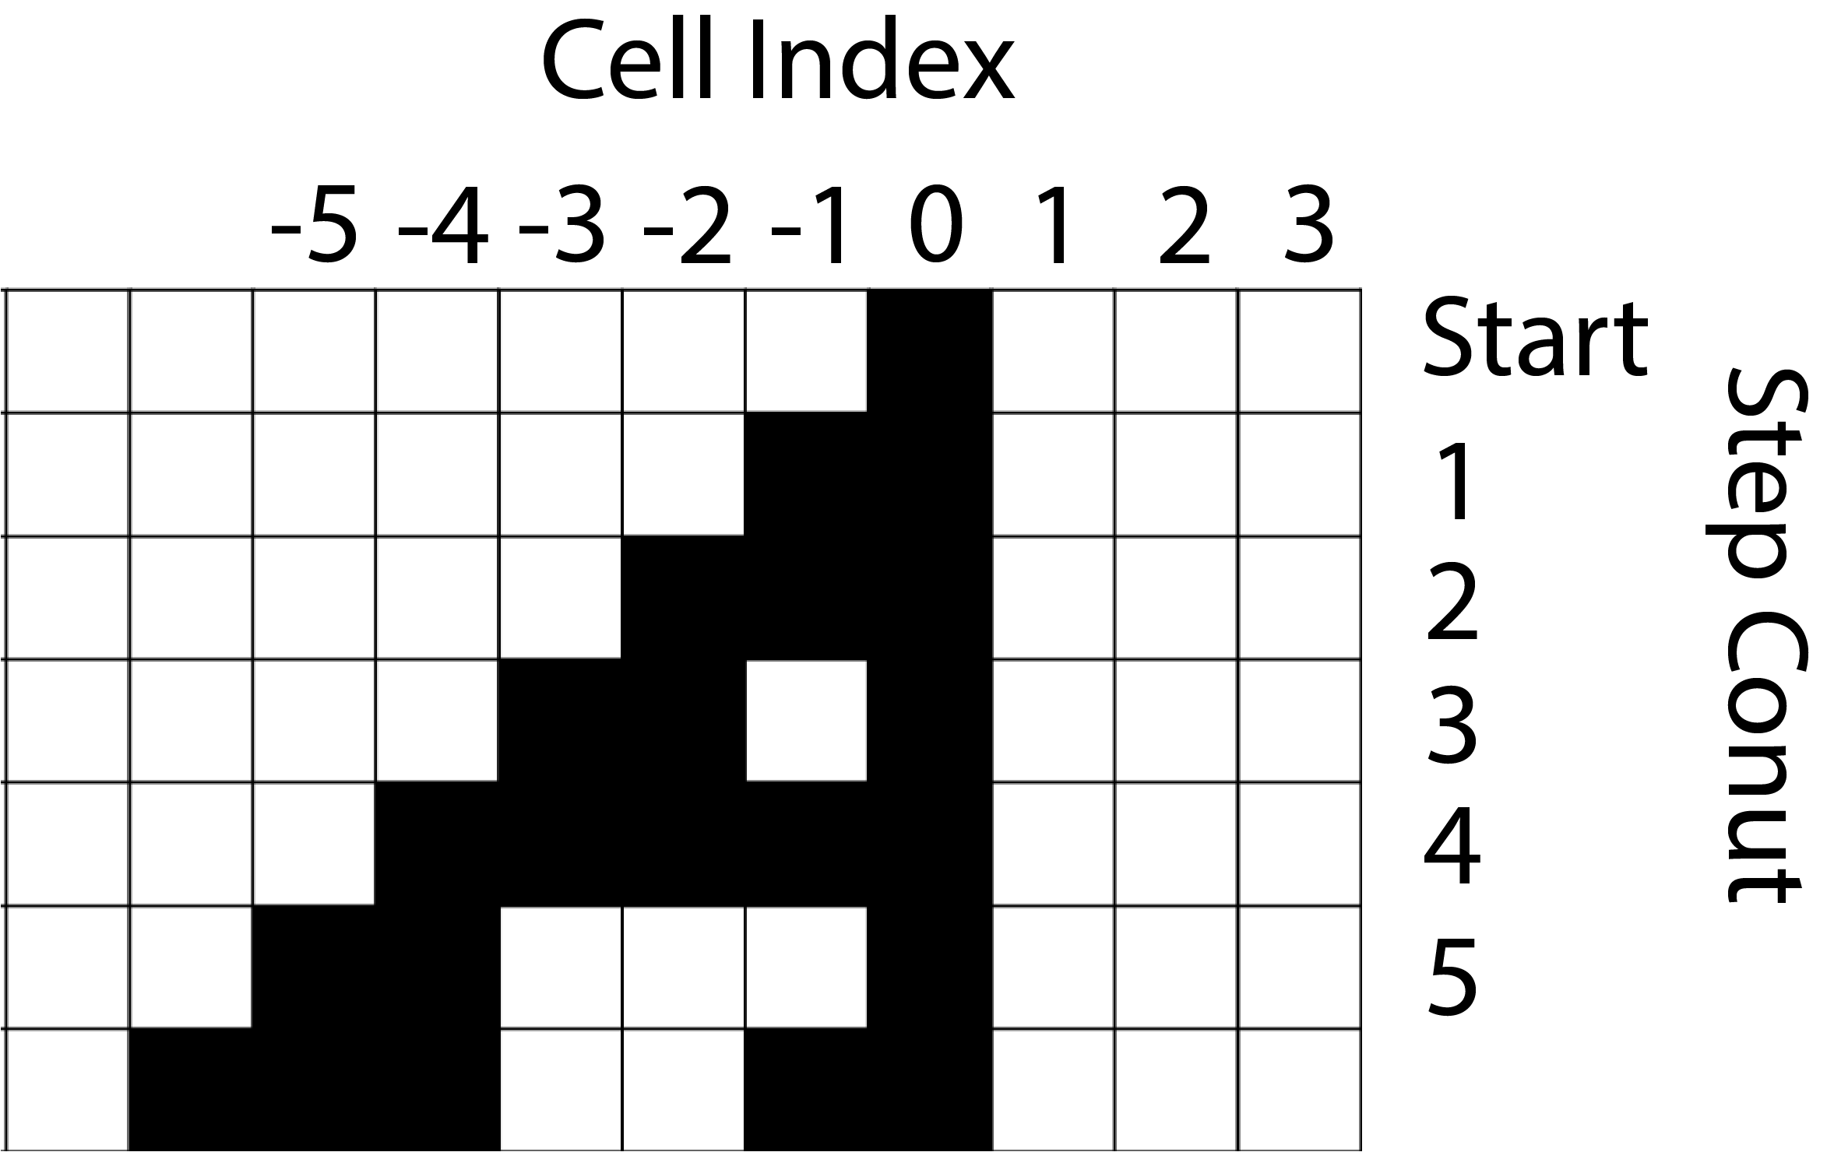
Rule 110 Automata
Cell active at Step X:
Starting cell: 0
-1, 0
-2, -1, 0
-3, - 2, 0
-4,-3,-2,-1, 0
-5, -4, 0
Current pattern | 111 | 110 | 101 | 100 | 011 | 010 | 001 | 000
New Cell Value | 0 | 1 | 1 | 0 | 1 | 1 | 1 | 0

Slide 33
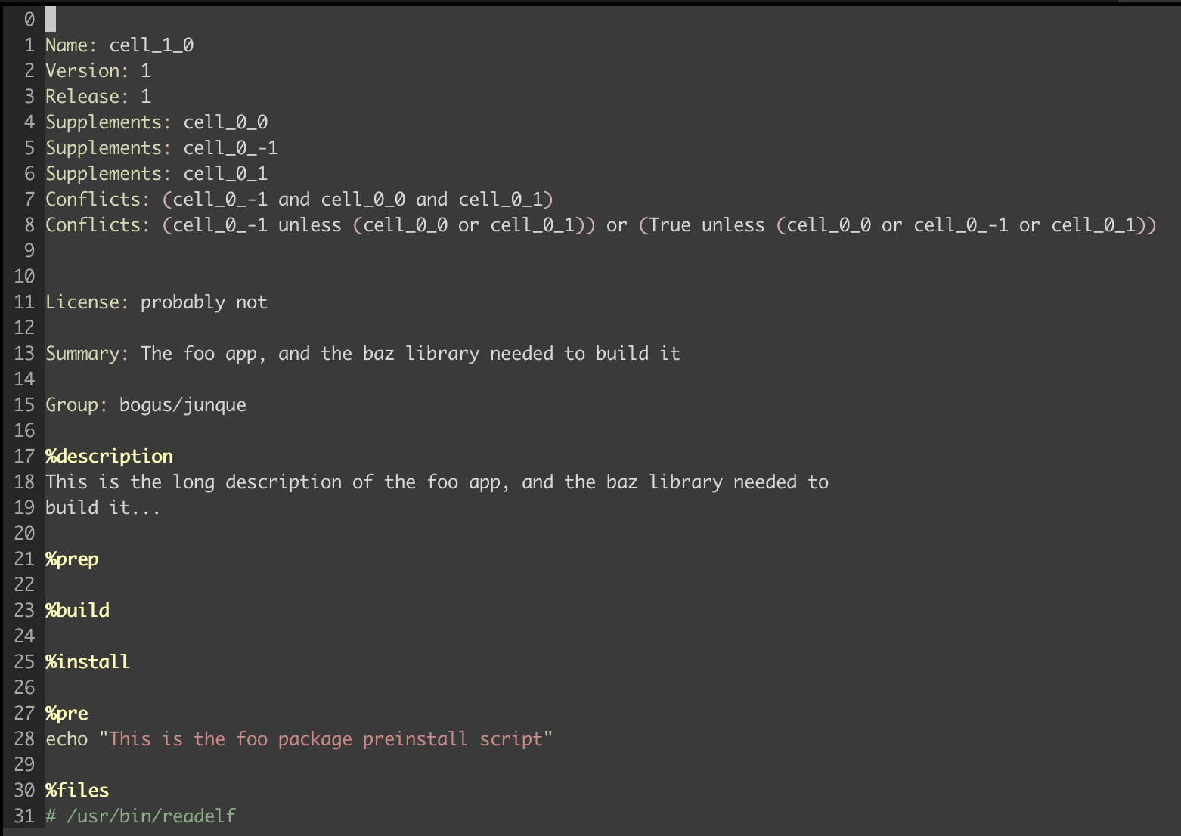
Rule 110 Automaton
Notes:
Represent each cell as a package.

Slide 34
Rule 110 Automaton: Package Requirements

Slide 35
Rule 110 Automaton: Conditional installs

Slide 36
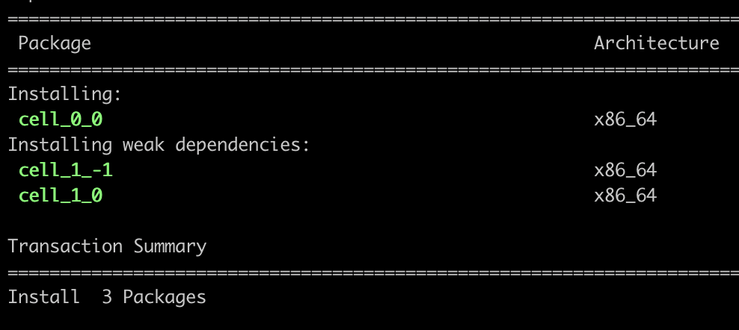
Rule 110 Automaton
Source: RPM documentation [4]

Slide 37
Demo: Rule 110 Automata
Packages installed at Step X:
Start: 0 <- Input package
-1, 0
-2, -1, 0
-3, - 2, 0
-4,-3,-2,-1, 0
-5, -4, 0

Slide 38
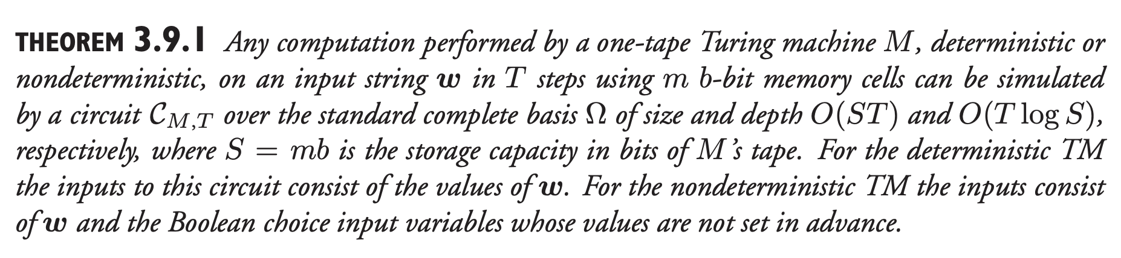
Section 3.9, Models of Computation – John E. Savage

Slide 39
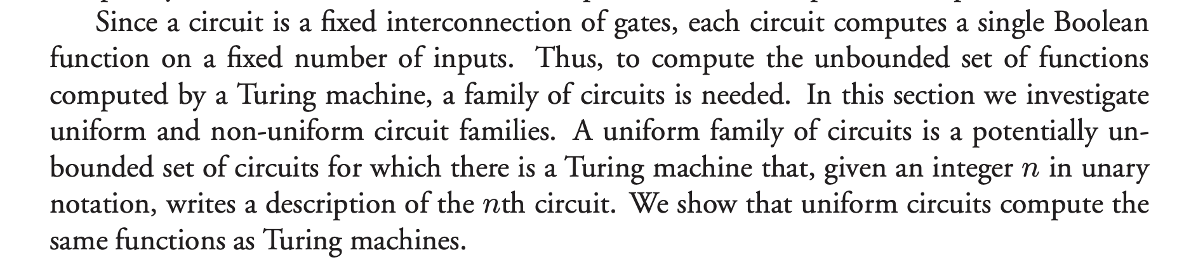
Section 8.13, Models of Computation – John E. Savage

Slide 40
RPM Triggers!
Another way to loop!

Slide 41
RPM TRIGGERS
“Triggers provide a well-defined method for packages to interact with one another at package install and uninstall time. They … execute an action when the installation status of another package (the "target" of the trigger) changes.”
– RPM API Documentation (v4.4.2.2)

Slide 42
AN
EXAMPLE RPM
TRIGGER
…

Slide 43
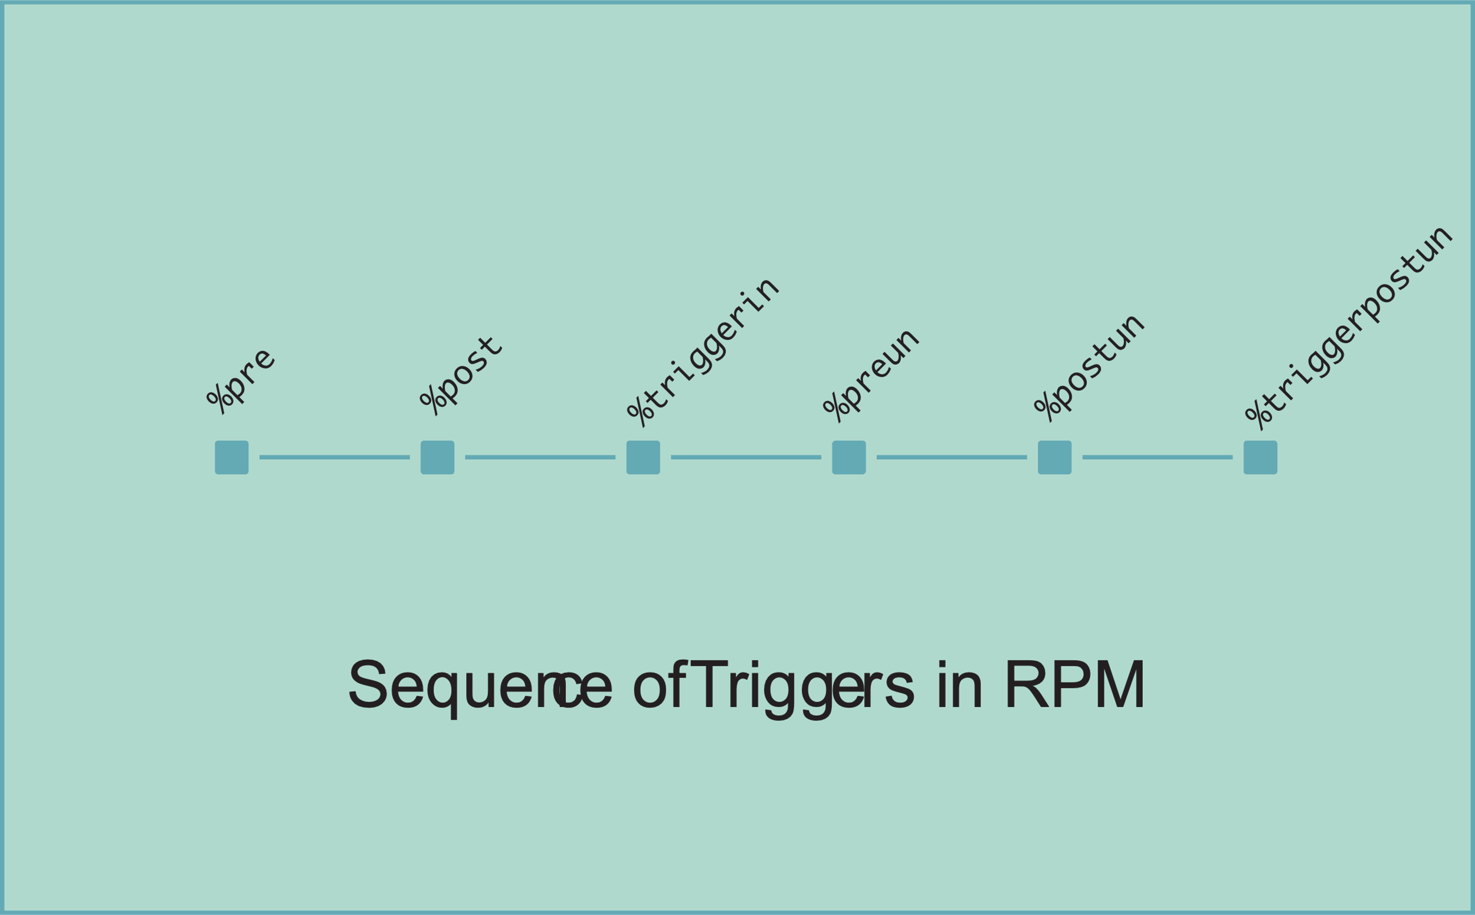

Slide 44
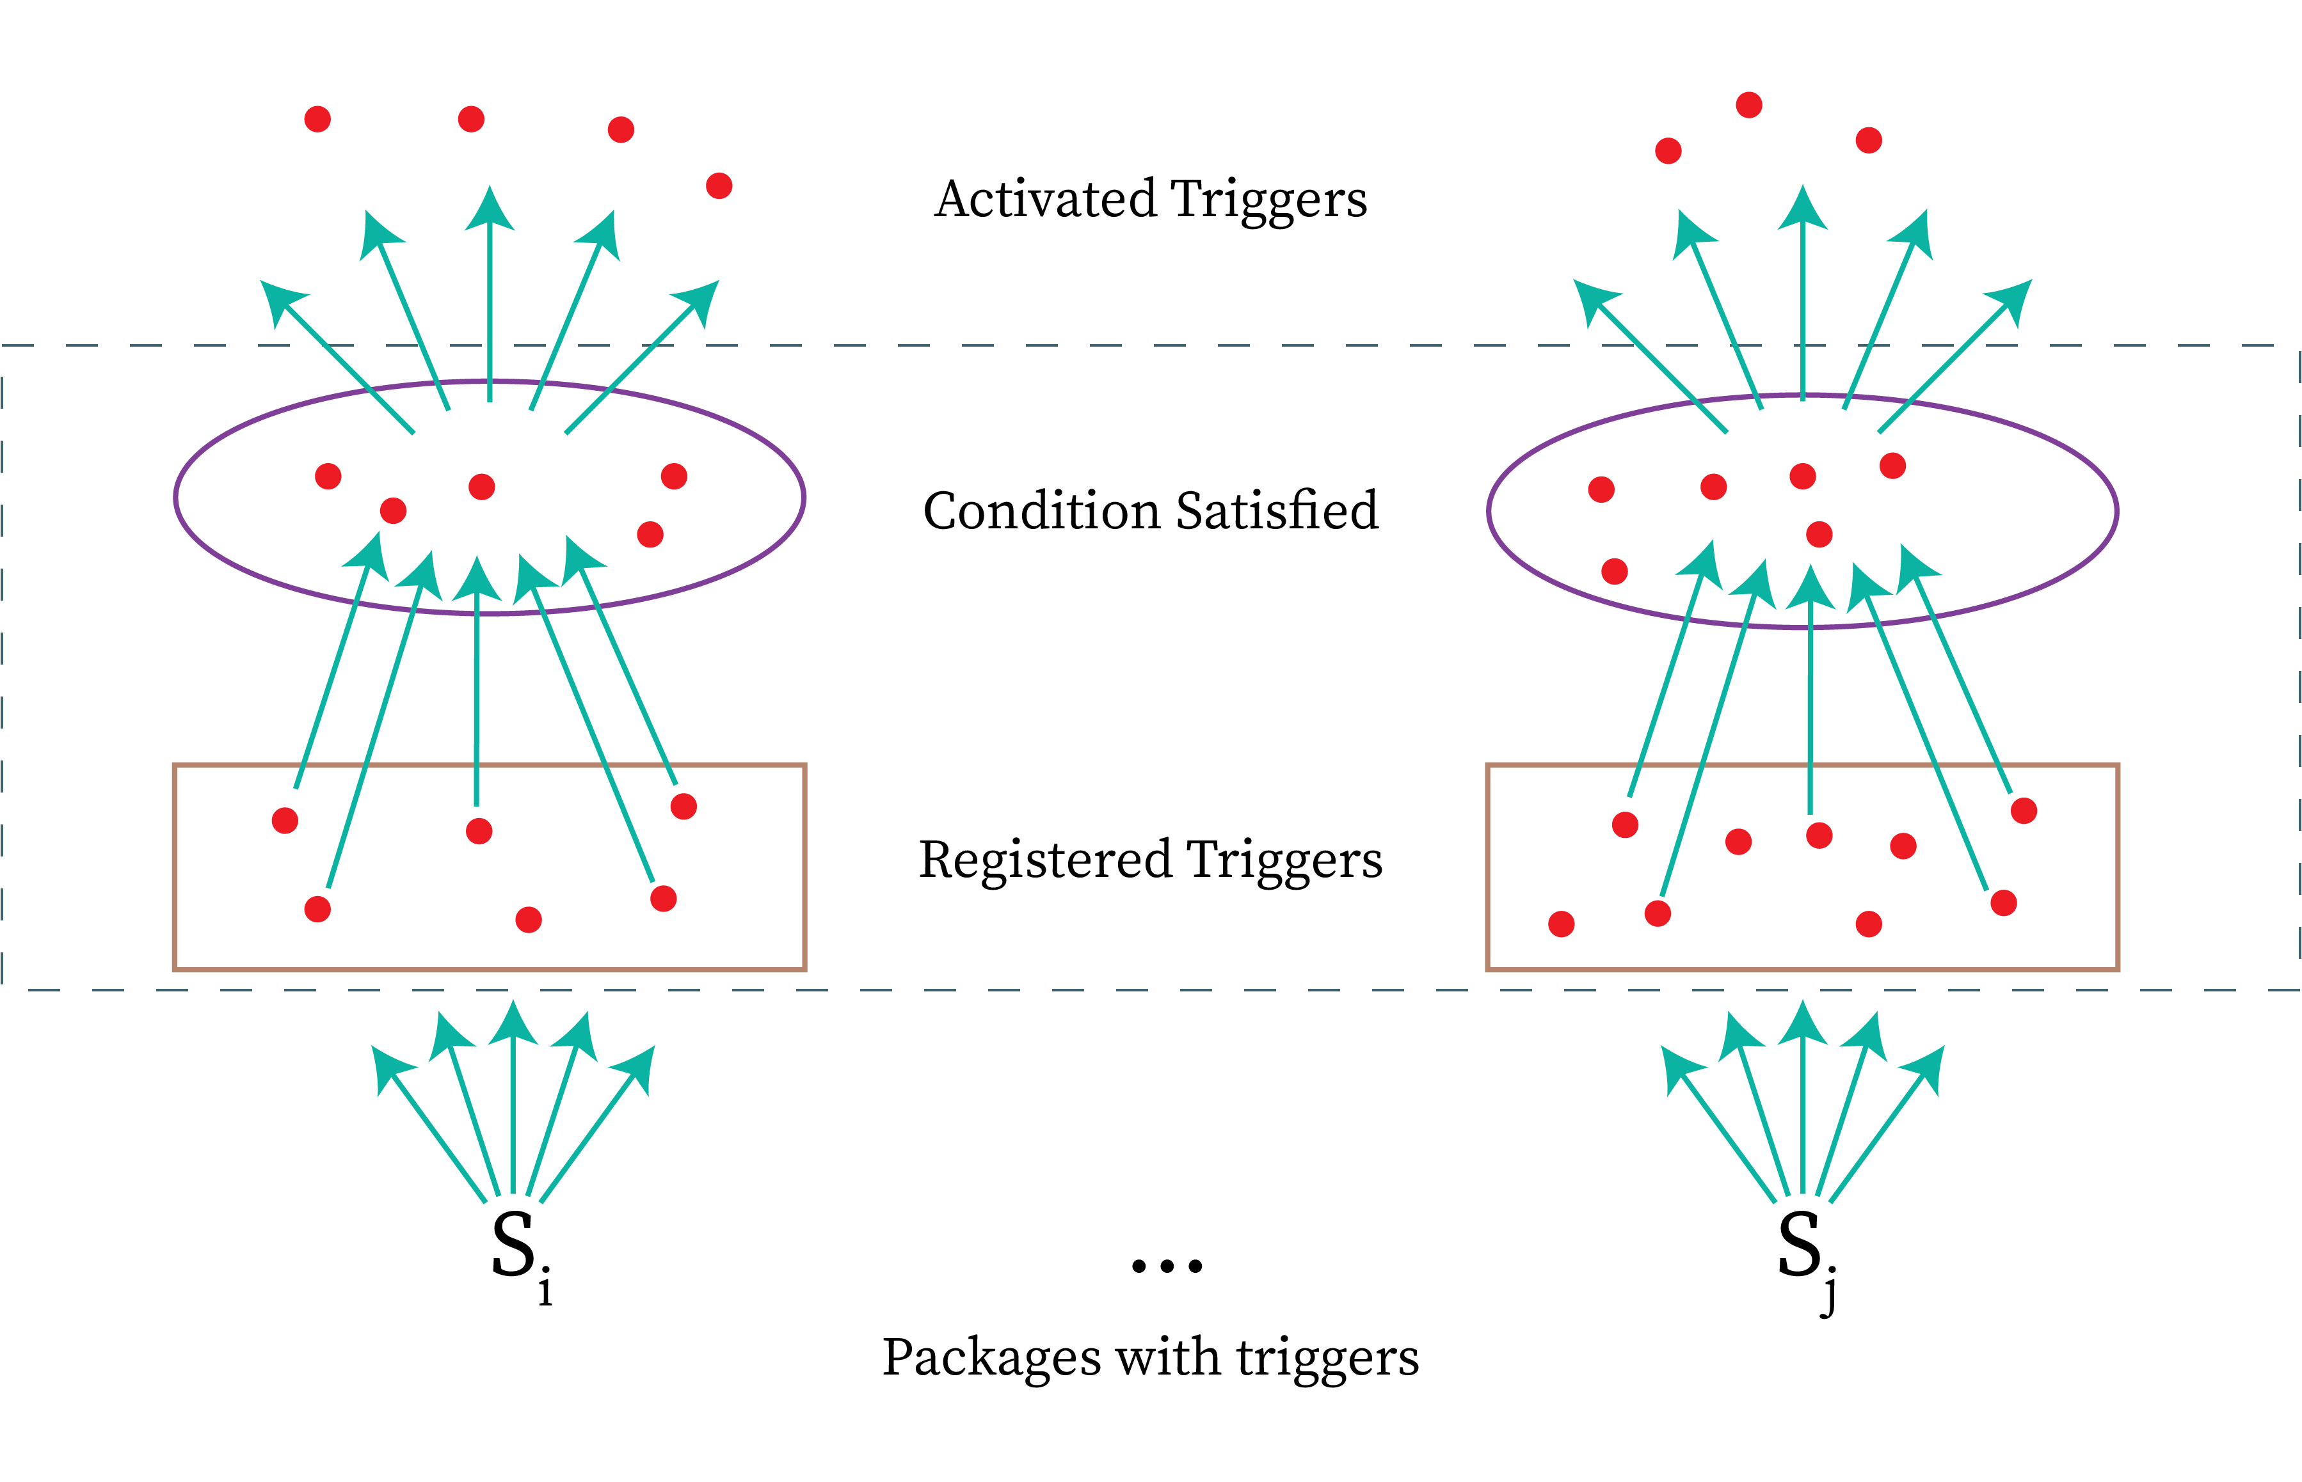

Slide 45
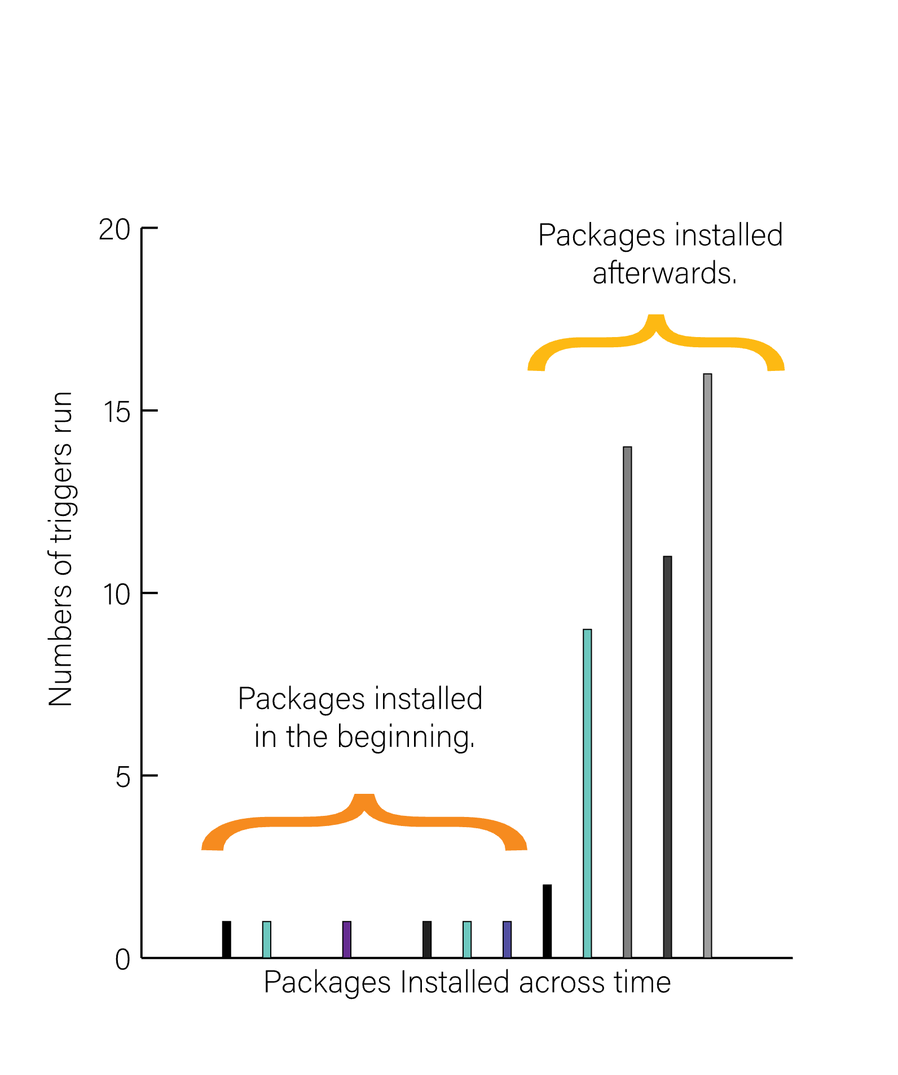
RPM TRIGGERS MAY
ACCUMULATE OVERTIME

Slide 46
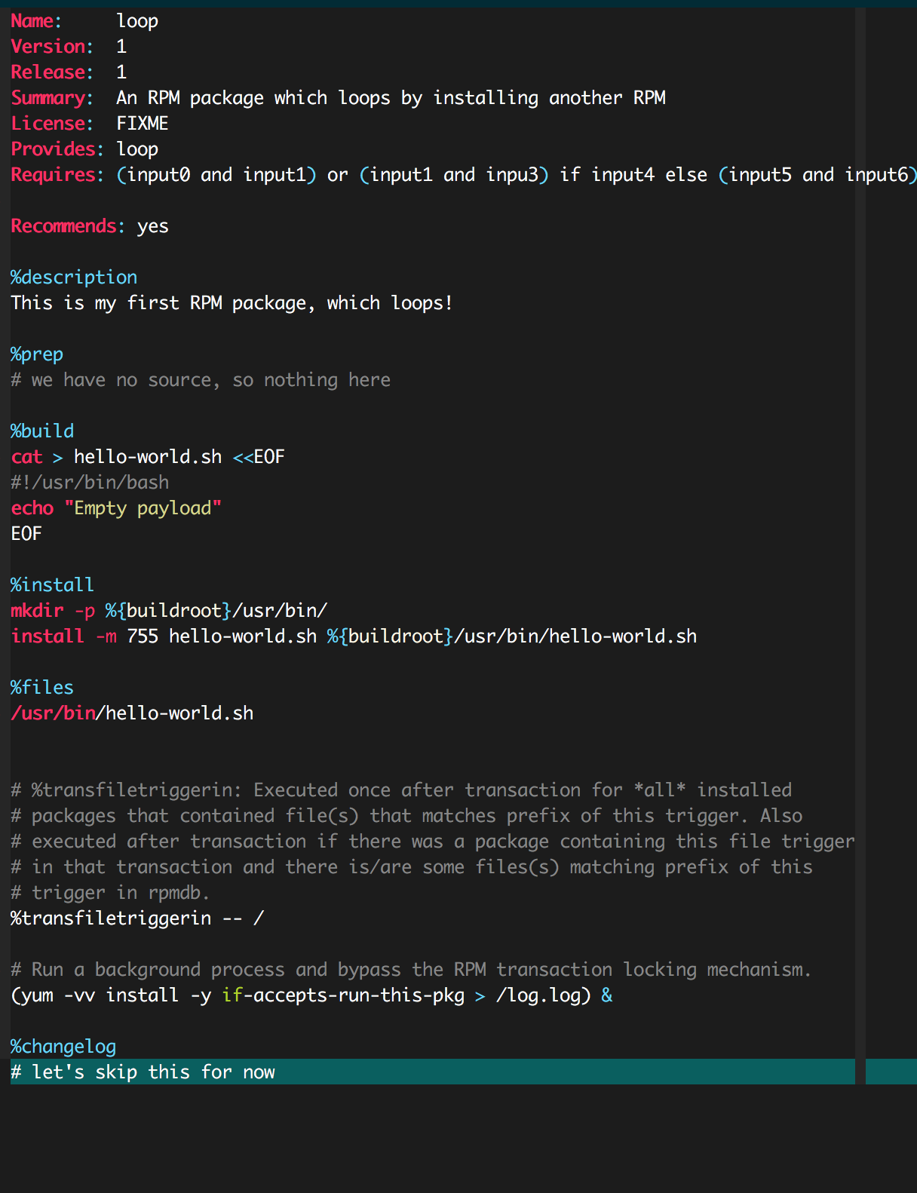
EXAMPLE WEIRD MACHINE
Use the RPM trigger mechanism requests another package install!
Launch a background process to bypass the transaction lock
This trigger will be run every time a non-empty package is installed on system.

Slide 47
EXAMPLE WEIRD MACHINE
‘Circuit’: the “Requires” line.
‘Input’: installed packages on system i.e, input0, input1 etc.
‘Instruction’ seq: Multiple packages each with requires dep that gets evaluated
‘Results’ : if the condition in requires is satisfied, then yum install command will run. Server knows circuit succeeded because request for package “yes.rpm” was made.

Slide 48
A Lesson in Secure System Design!
Composition of Bash with RPM metadata leads to emergent functionality!

Slide 49
COMPUTATION IN PACKAGE NAMESPACE
Achieved a malicious RPM server with the ability to send an arbitrary circuit and partial set of inputs for remote evaluation. This computation is done in the package namespace.
Notes:
TIME: 18 Minutes

Slide 50
SIGNIFICANCE
Rootkits in package management infrastructure.
WM is indistinguishable from a set of valid package installs.

Slide 51

Conclusion
Demonstrate RPM metadata can embed arbitrary computation!
Document an analysis technique for design time analysis and discovery of WMs
Future Work:
Built WMs in the cloud!
Emergent properties in networked systems.

Slide 52
Thank You!

Slide 53
Citations
[3] https://googleprojectzero.blogspot.com/2021/12/a-deep-dive-into-nso-zero-click.html
[4] https://rpm-software-management.github.io/rpm/manual/dependencies.html

